Slide 1

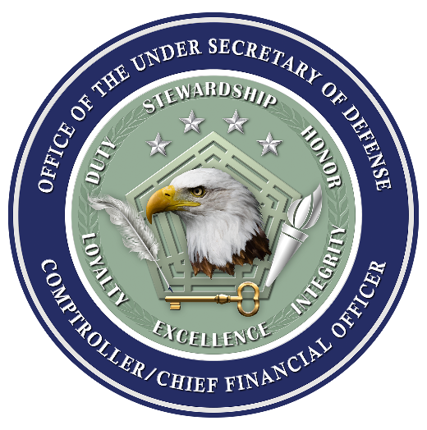
PPBE Reform
ASMC PDI March 13, 2024
Notes:
Add questions slide
10-15 minutes each Deputy Comptroller is 50-75 minutes. Questions at the end. One slide per recommendation. Pictures are welcomed.
R1: Midyr update (PB)
R2: Restructure j-books (PB)
R3: Improve training jbooks (HCRM)
R4: DoD liaison training (BAA)
R5: BLI consolidation (PB)
R6: Update PPBE documents (DCFO)
R7: Understanding of private sector practices (A&S)
R8: OSDC/CAPE IT consolidation (PB)
R9: Advana PPBE analytics (EFT) R10: Annual report PPBE business systems (EFT)
R11: Class/Unclass enclaves (CDAO)
R12: Recruiting and retention (HCRM)
R13: Streamline improve analytics reduce workload (EFT)

Slide 2

PPBE Reform
Message from Honorable Kathy Miller, Deputy Under Secretary of Defense (Comptroller)
Opening by Mr. Steffens, Deputy Comptroller
Introduction of Panel
Deputy Comptrollers Discussion on Implementing the Recommendations from the Commission on PPBE Reform
Questions
Notes:
Tighten these words up- too wordy

Slide 3
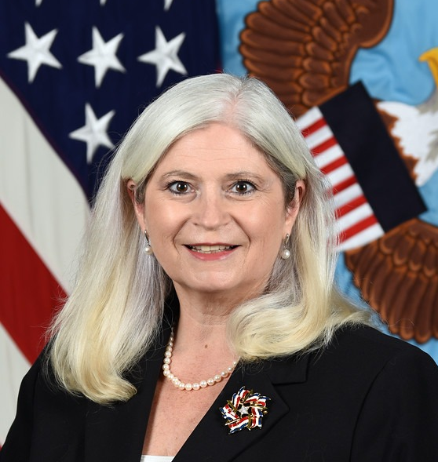
Message from
Honorable Kathy Miller
Deputy Under secretary of Defense (Comptroller)

Slide 4
Opening Message and Panel Introduction
Notes:
Insert # of recommendations. How many primary stakeholders. Other interesting items for the community.

Slide 5
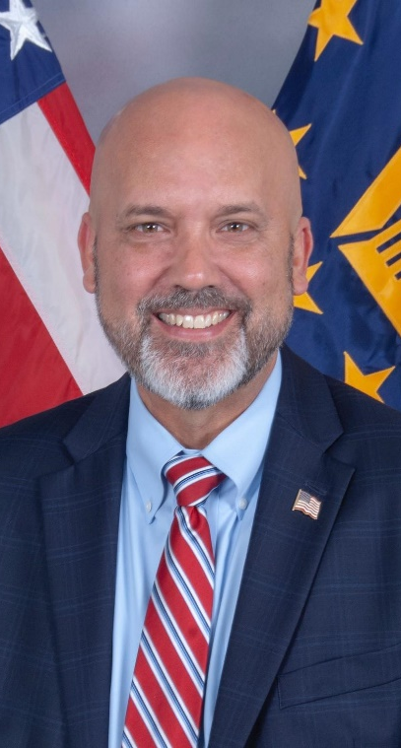
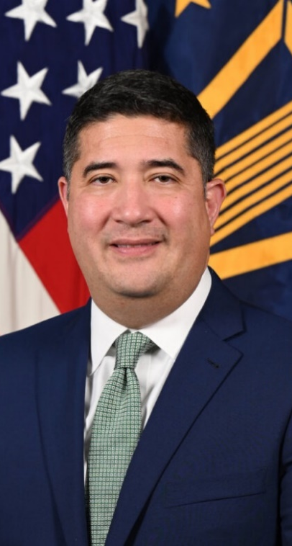
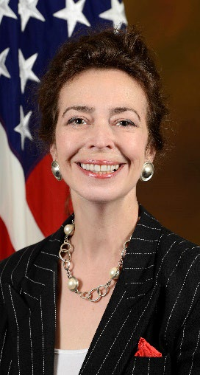
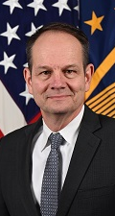
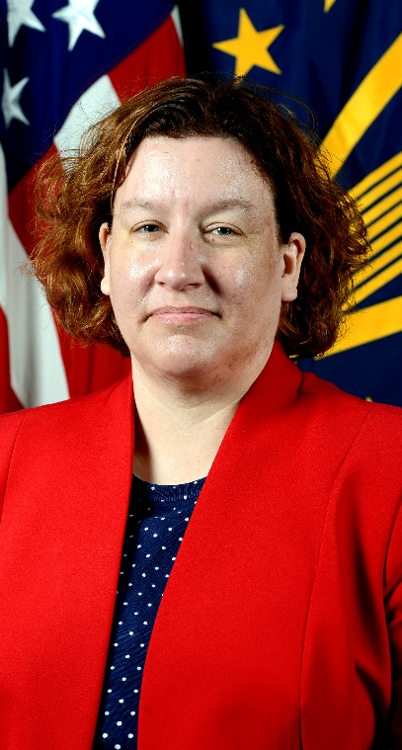
Office of the Under Secretary of Defense (Comptroller)/CFO
Mr. Mike Beaupre
Director for Human Capital and Resource Management (HCRM)
Mr. Jay Alonzo
Assistant Deputy Comptroller for Budget and Appropriations Affairs
(BAA)
Ms. Krysty Kolesar
Deputy Comptroller for Enterprise Financial Transformation (EFT)
Mr. Tom Steffens
Deputy Chief Financial Officer (DCFO)
Ms. Michele Bail
Director for Program & Financial Control (P&FC)
Notes:
Insert Names and Titles of Deputy Comptrollers

Slide 6
Office of the Deputy Comptroller, Program Budget (PB)
Ms. Michele Bail
Director for Program & Financial Control (P&FC)
Notes:
Insert Names and Titles of Deputy Comptrollers

Slide 7
Midyear Update Briefing to Congress
Final Report: Encourage Improved In-Person Communications
Program & Budget
Commission recommends DoD establish a process that engages with Congress on a more frequent basis to improve communication and share relevant information with Congress.
Objective. Institutionalize a process to provide Congress information on budget updates prior to enactment and improve communications on current execution.
Key Activities.
  Assemble cross-functional team to develop the criteria, process, and delivery method.
  Planning efforts underway; kick-off expected in April - June.
FM Strategy. Supports Strategic Goal #2 to optimize taxpayer dollars for the highest value outcomes.
How can the FM Community support this implementation. Continuous engagement with OUSD(C) on programmatic, budget, emerging technology, and geopolitical updates.
Notes:
10-15 minutes each Deputy Comptroller is 50-75 minutes. Questions at the end. One slide per recommendation. Pictures are welcomed.
R1: Midyr update (PB)
R2: Restructure j-books (PB)
R3: Improve training jbooks (HCRM)
R4: DoD liaison training (BAA)
R5: BLI consolidation (PB)
R6: Update PPBE documents (DCFO)
R7: Understanding of private sector practices (A&S)
R8: OSDC/CAPE IT consolidation (PB)
R9: Advana PPBE analytics (EFT) R10: Annual report PPBE business systems (EFT)
R11: Class/Unclass enclaves (CDAO)
R12: Recruiting and retention (HCRM)
R13: Streamline improve analytics reduce workload (EFT)

Slide 8
Restructure Budget Justification Books
Program & Budget
Commission recommends that the DoD should work with Congress to establish common formats and content for the J-books to provided needed content in a common format.
Objective. Propose new a justification book structure that presents a strategy linked explanation of programs and funding, provides content for cross-cutting programs and activities, and presents program details evenly and efficiently.
Key Activities.
  Assemble a cross-functional working group and work with Congress to assess changes to the J-books.
  Planning efforts underway; kick-off efforts will begin April – May.
FM Strategy. Supports Strategic Goals #2, 4, and 5 to optimize taxpayer dollars for the highest value outcomes, simplify policy to support productive change, and improve data quality to make data easier to use for decision-making.
How can the FM Community support this implementation. Provide feedback on opportunities for restructure and supporting approved restructure efforts.
Notes:
10-15 minutes each Deputy Comptroller is 50-75 minutes. Questions at the end. One slide per recommendation. Pictures are welcomed.
R1: Midyr update (PB)
R2: Restructure j-books (PB)
R3: Improve training jbooks (HCRM)
R4: DoD liaison training (BAA)
R5: BLI consolidation (PB)
R6: Update PPBE documents (DCFO)
R7: Understanding of private sector practices (A&S)
R8: OSDC/CAPE IT consolidation (PB)
R9: Advana PPBE analytics (EFT) R10: Annual report PPBE business systems (EFT)
R11: Class/Unclass enclaves (CDAO)
R12: Recruiting and retention (HCRM)
R13: Streamline improve analytics reduce workload (EFT)

Slide 9
Review and Consolidation of Budget Line Items
Program & Budget
Commission recommends that Congress and DoD work to systematically review and restructure budget lines and accounts where possible.
Objective. Review and consolidate the existing number of budget line items, while preserving congressional transparency and oversight.
Key Activities.
  OUSD(C) is conducting an initial review and will establish a cross-functional team to assess opportunities.
  Planning efforts are underway; kick-off efforts will begin in April – May.
FM Strategy. Supports Strategic Goals #2, 4, and 5 to optimize taxpayer dollars for the highest value outcomes, simplify policy to support productive change, and improve data quality to make data easier to use for decision-making.
How can the FM Community support this implementation. Provide feedback on potential consolidation options.
Notes:
10-15 minutes each Deputy Comptroller is 50-75 minutes. Questions at the end. One slide per recommendation. Pictures are welcomed.
R1: Midyr update (PB)
R2: Restructure j-books (PB)
R3: Improve training jbooks (HCRM)
R4: DoD liaison training (BAA)
R5: BLI consolidation (PB)
R6: Update PPBE documents (DCFO)
R7: Understanding of private sector practices (A&S)
R8: OSDC/CAPE IT consolidation (PB)
R9: Advana PPBE analytics (EFT) R10: Annual report PPBE business systems (EFT)
R11: Class/Unclass enclaves (CDAO)
R12: Recruiting and retention (HCRM)
R13: Streamline improve analytics reduce workload (EFT)

Slide 10
Accelerate OSD Comptroller and CAPE IT System Consolidation
Final Report: Continue Rationalization of the OSD Resourcing Systems
Program & Budget
Commission recommends the OUSD(C) work with CAPE to consolidate IT efforts and streamline existing PPBE processes with the end goal of having a single authoritative resource management system.
Objective. Continue efforts to consolidates program and budget data systems via the Next Generation Resource Management System (NGRMS).
Key Activities.
  Expand incrementally and adapt to new requirements and emerging technologies.
  FY 2024 activities: source execution data from Advana; new single sign-on/users management module; cloud containerization; and assessment of DoD component Budget formulation systems architectures.
FM Strategy. Supports Strategic Goals #2, 4, and 5 to optimize taxpayer dollars for the highest value outcomes, simplify policy to support productive change, and improve data quality to make data easier to use for decision-making.
How can the FM Community support this implementation. Provide input on functional and technical requirements.
Notes:
10-15 minutes each Deputy Comptroller is 50-75 minutes. Questions at the end. One slide per recommendation. Pictures are welcomed.
R1: Midyr update (PB)
R2: Restructure j-books (PB)
R3: Improve training jbooks (HCRM)
R4: DoD liaison training (BAA)
R5: BLI consolidation (PB)
R6: Update PPBE documents (DCFO)
R7: Understanding of private sector practices (A&S)
R8: OSDC/CAPE IT consolidation (PB)
R9: Advana PPBE analytics (EFT) R10: Annual report PPBE business systems (EFT)
R11: Class/Unclass enclaves (CDAO)
R12: Recruiting and retention (HCRM)
R13: Streamline improve analytics reduce workload (EFT)

Slide 11
Office of the Deputy Chief Financial Officer (DCFO)
Mr. Tom Steffens
Deputy Chief Financial Officer
Notes:
Insert Names and Titles of Deputy Comptrollers

Slide 12
Review and Update PPBE-related guidance documents
Deputy CFO
A systematic revision and update to the FMR and DoDD 7045.14.
Objective. To provide a clear, consistent, and current guidance that enables efficient and effective decision making at the lowest levels.
Key Activities.
  Identify FMR chapters that require revision.
  Update and reissue the DoDD 7045.14.
  Revised chapters will be published through the end of 2026.
FM Strategy. Supports Strategic Goals #1, 2, and 4 to Cultivate a skilled and inspired FM workforce, optimize taxpayer dollars for the highest value outcomes, and simplify policy to support productive change.
How can the FM Community support this implementation. Leadership, team focus, planning and resources.
Notes:
10-15 minutes each Deputy Comptroller is 50-75 minutes. Questions at the end. One slide per recommendation. Pictures are welcomed.
R1: Midyr update (PB)
R2: Restructure j-books (PB)
R3: Improve training jbooks (HCRM)
R4: DoD liaison training (BAA)
R5: BLI consolidation (PB)
R6: Update PPBE documents (DCFO)
R7: Understanding of private sector practices (A&S)
R8: OSDC/CAPE IT consolidation (PB)
R9: Advana PPBE analytics (EFT) R10: Annual report PPBE business systems (EFT)
R11: Class/Unclass enclaves (CDAO)
R12: Recruiting and retention (HCRM)
R13: Streamline improve analytics reduce workload (EFT)

Slide 13
Office of the Deputy Comptroller, Enterprise Financial Transformation (EFT)
Ms. Krysty Kolesar
Deputy Comptroller
Notes:
Insert Names and Titles of Deputy Comptrollers

Slide 14
Expand PPBE Analytics via Advana
Deputy Comptroller for Enterprise Financial Transformation (EFT)
The Commission recommends the OUSD(C), develop an implementation plan to expand the scope of analytics of the PPBE process within Advana.
Objective. To leverage Advana within the PPBE process for enhanced analytics and decision-making to improve resource allocation and efficiency.
Key Activities.
  Assessment and Planning
  Expand Data Ingestion in Advana
  Expand using Advana in the Mid-Year Review Process
  Incorporate Artificial Intelligence (AI)/Machine Learning (ML) for predictive modeling
  Integrate General Ledger Execution Data
  DoD Dashboard Development & Enhancement
FM Strategy. Supports Strategic Goals #2, 4, and 5 to optimize taxpayer dollars for the highest value outcomes, simplify policy to support productive change, and improve data quality to make data easier to use for decision-making.
How can the FM Community support this implementation. Collaboration with stakeholders for smooth data integration.
Notes:
10-15 minutes each Deputy Comptroller is 50-75 minutes. Questions at the end. One slide per recommendation. Pictures are welcomed.
R1: Midyr update (PB)
R2: Restructure j-books (PB)
R3: Improve training jbooks (HCRM)
R4: DoD liaison training (BAA)
R5: BLI consolidation (PB)
R6: Update PPBE documents (DCFO)
R7: Understanding of private sector practices (A&S)
R8: OSDC/CAPE IT consolidation (PB)
R9: Advana PPBE analytics (EFT) R10: Annual report PPBE business systems (EFT)
R11: Class/Unclass enclaves (CDAO)
R12: Recruiting and retention (HCRM)
R13: Streamline improve analytics reduce workload (EFT)

Slide 15
Streamline Processes and Improve Analytic Capabilities to Reduce Workload
Deputy Comptroller for Enterprise Financial Transformation (EFT)
The Commission recommends the DoD improve analytic capabilities to reduce the workload in the PPBE process, including optimizing the use of the Advana for budgetary analytic capabilities, and streamlining the organizational structure.
Objective. By leveraging technology and optimizing organizational structures, the Department’s objective aims to reduce workload, improve operational efficiency, and support more effective decision making.
Key Activities.
  Enhance budgetary and execution trend analysis
  Change Management program
  Streamline and automate data ingestion process
  Data Entry Application and Management
FM Strategy. Supports Strategic Goals #2, 4, and 5 to optimize taxpayer dollars for the highest value outcomes, simplify policy to support productive change, and improve data quality to make data easier to use for decision-making.
How can the FM Community support this implementation. Policy Development and Implementation, Technical Expertise and Training, and Collaboration and Coordination
Notes:
10-15 minutes each Deputy Comptroller is 50-75 minutes. Questions at the end. One slide per recommendation. Pictures are welcomed.
R1: Midyr update (PB)
R2: Restructure j-books (PB)
R3: Improve training jbooks (HCRM)
R4: DoD liaison training (BAA)
R5: BLI consolidation (PB)
R6: Update PPBE documents (DCFO)
R7: Understanding of private sector practices (A&S)
R8: OSDC/CAPE IT consolidation (PB)
R9: Advana PPBE analytics (EFT) R10: Annual report PPBE business systems (EFT)
R11: Class/Unclass enclaves (CDAO)
R12: Recruiting and retention (HCRM)
R13: Streamline improve analytics reduce workload (EFT)

Slide 16
Provide annual report and briefing to Congress on DoD’s strategy for consolidating, rationalizing, integration, and modernizing DoD PPBE business systems
Deputy Comptroller for Enterprise Financial Transformation (EFT)
The Commission recommends the DoD provide congressional defense committees an annual report and briefing on the Department’s strategy for consolidating, rationalizing, integrating, and modernizing DoD PPBE business systems, feeder systems, platforms, databases, and tools used to support the PPBE process.
Objective. To provide Congress with annual report & briefing highlighting accomplishments in the Department’s implementation of PPBE system consolidation and modernization efforts, to include on-going process for assessing and identifying additional consolidation and modernization opportunities.
Key Activities.
  Validate and maintain accurate & complete PPBE system scope (May 2024, ongoing)
  Develop / leverage IT Analytics to manage and assess portfolio (Ongoing)
  Conduct rationalization and prioritization assessments (ongoing)
  Initial Report and Briefing submitted (~Sept 2024, within 6 months of final PPBE report)
FM Strategy. Supports Strategic Goals #2, 3, 4, and 5 to optimize taxpayer dollars for the highest value outcomes, simplify policy to support productive change, and improve data quality to make data easier to use for decision-making.
How can the FM Community support this implementation. Collaboration and coordination with stakeholders
Notes:
10-15 minutes each Deputy Comptroller is 50-75 minutes. Questions at the end. One slide per recommendation. Pictures are welcomed.
R1: Midyr update (PB)
R2: Restructure j-books (PB)
R3: Improve training jbooks (HCRM)
R4: DoD liaison training (BAA)
R5: BLI consolidation (PB)
R6: Update PPBE documents (DCFO)
R7: Understanding of private sector practices (A&S)
R8: OSDC/CAPE IT consolidation (PB)
R9: Advana PPBE analytics (EFT) R10: Annual report PPBE business systems (EFT)
R11: Class/Unclass enclaves (CDAO)
R12: Recruiting and retention (HCRM)
R13: Streamline improve analytics reduce workload (EFT)

Slide 17
Office of the Deputy Comptroller, Budget and Appropriations Affairs
(BAA)
Mr. Jay Alonzo
Assistant Deputy Comptroller
Notes:
Insert Names and Titles of Deputy Comptrollers

Slide 18
Improve Training for DoD Liaisons
Deputy Comptroller for Budget and Appropriations Affairs (BAA)
Standardize training for Congressional Liaisons.
Objective. Develop training and education to ensure Liaisons possess the required knowledge and skills.
Key Activities.
  Identify existing liaison positions within the Department
  Capture training best practices from across the Department and Services
  Provide and Track Training beginning in Q2 of CY24
FM Strategy. Supports Strategic Goal #1 to cultivate a skilled and inspired FM workforce.
How can the FM Community support this implementation. Codify requirements in DoD guidance. Emphasize the importance of timely Authorizations and Appropriations to the PPBE process.
Notes:
10-15 minutes each Deputy Comptroller is 50-75 minutes. Questions at the end. One slide per recommendation. Pictures are welcomed.
R1: Midyr update (PB)
R2: Restructure j-books (PB)
R3: Improve training jbooks (HCRM)
R4: DoD liaison training (BAA)
R5: BLI consolidation (PB)
R6: Update PPBE documents (DCFO)
R7: Understanding of private sector practices (A&S)
R8: OSDC/CAPE IT consolidation (PB)
R9: Advana PPBE analytics (EFT) R10: Annual report PPBE business systems (EFT)
R11: Class/Unclass enclaves (CDAO)
R12: Recruiting and retention (HCRM)
R13: Streamline improve analytics reduce workload (EFT)

Slide 19
Office of Human Capital and Resource Management (HCRM)
Mr. Mike Beaupre
Director for Human Capital and Resource Management (HCRM)
Notes:
Insert Names and Titles of Deputy Comptrollers

Slide 20
Continue the Focus on Improving Recruiting and Retention
Human Capital and Resource Management (HCRM)
Continue efforts to recruit and retain personnel.
Objective
  Increase recruitment and retention through better identification and management of potential talent using coordinated engagement and information sharing
Key Activities
  Phase 1: Design
  Phase 2: Stand up
  Phase 3:
    FY24 2nd Qtr Pilot Execution
    Spring / Summer Analyze, develop final report: metrics, reviews key findings, identifies best practices, and, if warranted, recommends enterprise recruitment concept path operationalization
FM Strategy – Strategic Goal 1 to Cultivate a skilled and inspired FM Workforce.
How can the FM Community support this implementation- FM Senior Leaders and SME support pilot through recruiting events
Notes:
10-15 minutes each Deputy Comptroller is 50-75 minutes. Questions at the end. One slide per recommendation. Pictures are welcomed.
R1: Midyr update (PB)
R2: Restructure j-books (PB)
R3: Improve training jbooks (HCRM)
R4: DoD liaison training (BAA)
R5: BLI consolidation (PB)
R6: Update PPBE documents (DCFO)
R7: Understanding of private sector practices (A&S)
R8: OSDC/CAPE IT consolidation (PB)
R9: Advana PPBE analytics (EFT) R10: Annual report PPBE business systems (EFT)
R11: Class/Unclass enclaves (CDAO)
R12: Recruiting and retention (HCRM)
R13: Streamline improve analytics reduce workload (EFT)

Slide 21
Improve training for preparation of budget justification materials
Human Capital and Resource Management (HCRM)
The Commission recommends creation of training courses for various types of budget justification materials, including J-books, data files, and staffer briefings.
Objective
  Establish Department-wide standardized and structured Budget Justification Material Training
Key Activities
  Develop foundation in the justification material importance, developing and writing narratives, j-books, rollout briefings, talking points & supporting materials
  Potentially add curriculum to DFMCP*
  FY24 2nd Qtr: Establish DFMCP Requirements Review Committee (DRRC) & charter
  Summer 2024: Complete 3 DRRC reviews; competency, curriculum, & composition
  Fall 2024: Obtain FM Senior Leadership Group approval of DRRC recommendations and add training
FM Strategy – Strategic Goal 1 to Cultivate a skilled and inspired FM Workforce.
How can the FM Community support this implementation- FM Senior Leaders and SME support DRRC
*https://comptroller.defense.gov/External-Links/FMCert/
Notes:
10-15 minutes each Deputy Comptroller is 50-75 minutes. Questions at the end. One slide per recommendation. Pictures are welcomed.
R1: Midyr update (PB)
R2: Restructure j-books (PB)
R3: Improve training jbooks (HCRM)
R4: DoD liaison training (BAA)
R5: BLI consolidation (PB)
R6: Update PPBE documents (DCFO)
R7: Understanding of private sector practices (A&S)
R8: OSDC/CAPE IT consolidation (PB)
R9: Advana PPBE analytics (EFT) R10: Annual report PPBE business systems (EFT)
R11: Class/Unclass enclaves (CDAO)
R12: Recruiting and retention (HCRM)
R13: Streamline improve analytics reduce workload (EFT)

Slide 22
Questions?

