Slide 1
New Board Member Orientation
Template developed by
PowerPoint Template
Note: This template can be adapted by health centers for new board member orientation.
Notes:
Notes: This slide deck can be customized for your board’s orientation. This slide can be updated to include your health center’s name and logo. Please see the accompanying resources for possible orientation agendas. The template is designed to reflect a “multi-session approach” and you can reorganize the slides to match the agenda for board orientation being offered at your center.
Each slides contains “Notes” about how to consider using or adapting the slide. In some places where background on board roles is provided, “Potential Talking Points” are also included. Slides designed to be customized are designated as “Sample slides.”
Finally, the National Association of Community Health Centers, State and Regional Primary Care Associations, and other organizations make various technical assistance resources available on the Health Center Resource Clearinghouse that may further aid in board orientation (see https://www.healthcenterinfo.org/quick-finds-governance/). Some are linked in this document for ease of references or as suggestions to continue the learning process.

Slide 2
Session 1:
Welcome, Health Center Overview, and Introduction to Board Roles
Welcome/Getting to Know Each Other
History of the Health Center and the Health Center Movement
Vision, Mission, and Values
Health Center Overview and Strategic Plan Introduction
Introduction to Health Resources and Services Administration (HRSA) Health Center Program
Introduction to Board Roles
Questions and Answers
Notes:
Notes: This is a sample agenda for the slides as organized in the template. Reorganize the agenda slides – as needed – based on the orientation at your health center.

Slide 3

Welcome/Getting to Know Each Other
Welcome to the board
Personal introductions:
  Why do you choose to serve with the health center?
  Your background
  Anything else you’d like for us to know about you
Notes:
Notes: Use this time for introductions, to thank new members for agreeing to serve on the board, and to help them get to know one another and the board and staff members participating in the orientation.
The initial orientation session is an important first step in the board member life cycle and sets the tone for future engagement. Careful consideration should be given to the introduction process and relationship building. In a multi-session virtual format, consider having a mix of senior executive staff members along with an experienced board member or two for the sessions. It may also be beneficial to utilize a “board buddy”/mentor relationship to connect new members with more tenured board members.
In the getting to know you section, consider drawing out why new members decided to serve on the board. Understanding and appreciation of the personal connection to the mission will help bring the group together and allow the new members to connect with the center and more actively participate in governance.

Slide 4
History of the Health Center and the Health Center Movement
Sample slide – customize for your center
History of [insert Health Center Name]
[Insert background information on your health center – e.g., year founded, major milestones]
Notes:
Notes: It can be helpful for new members to understand the center’s history. Consider including a timeline of significant milestones in the life of your health center such as the date the FQHC received its status, service line additions, site expansions, New Access Point grants and key philanthropic support dates.

Slide 5
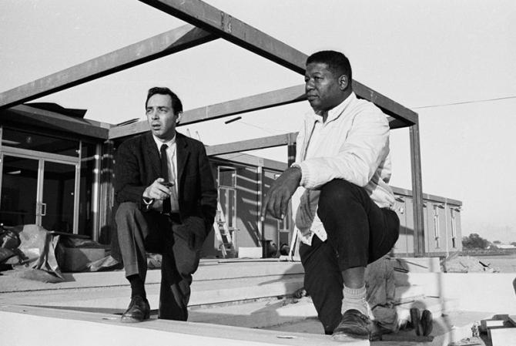
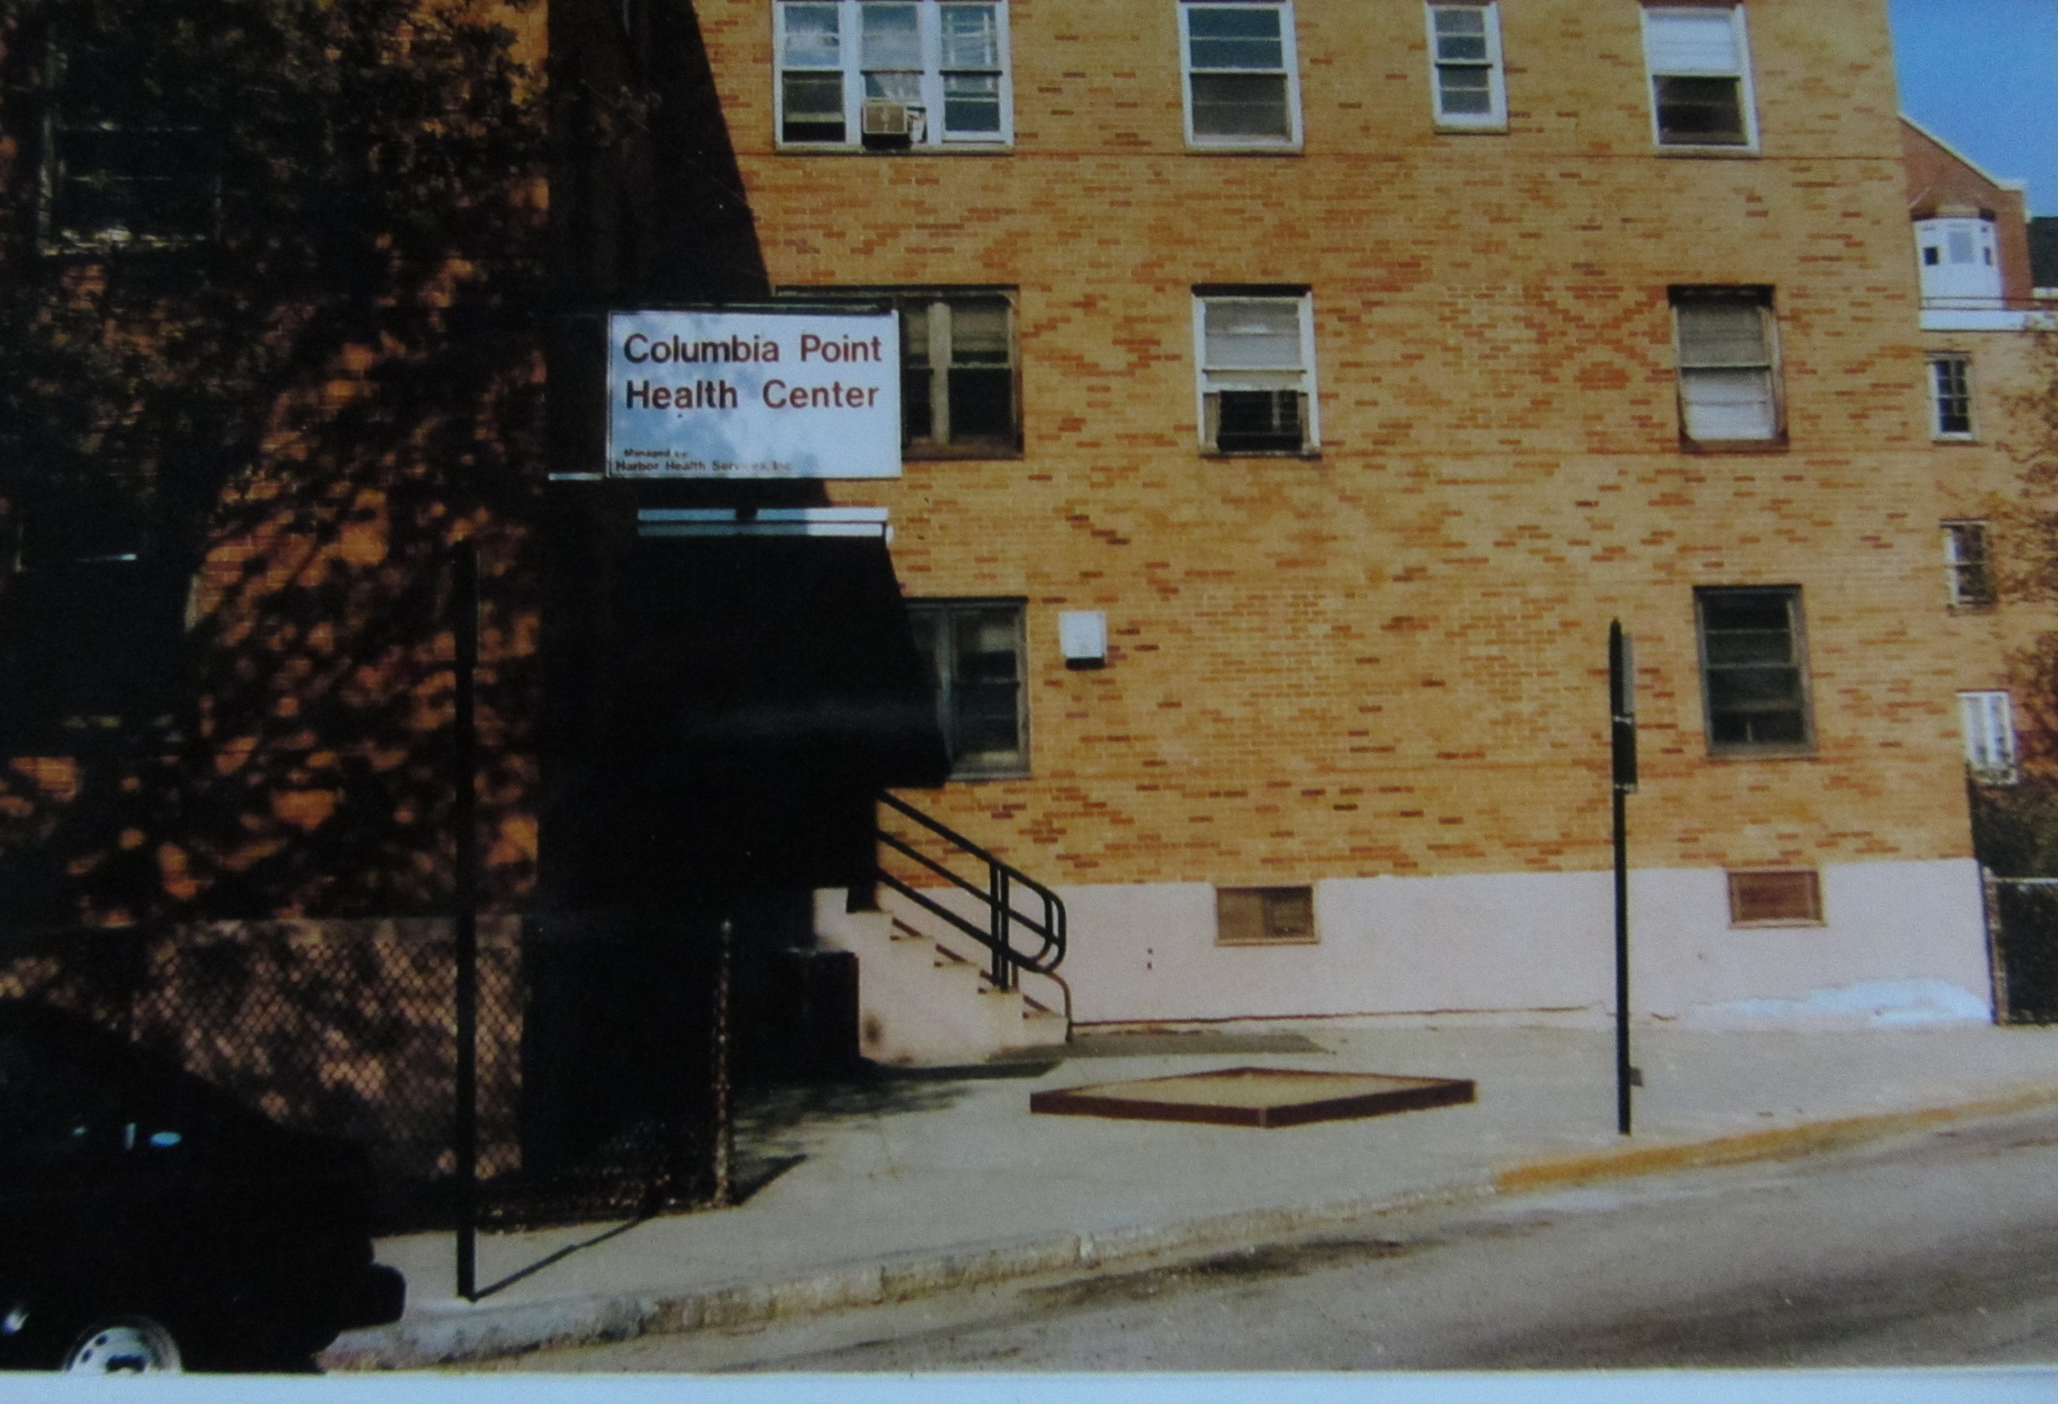
History of the Health Center and the Health Center Movement
The Health Center Movement
Dr. H. Jack Geiger and Dr. John W. Hatch during construction of the Delta Health Center
Columbia Point Health Center in the Dorchester neighborhood of Boston
Notes:
Notes: It can also be helpful for new members to understand that the health center and board are part of a broader health center movement. Below are some sample talking points. For additional history on the health center movement – including short videos - please see: https://www.chcchronicles.org/stories/community-health-centers-chronicling-their-history-and-broader-meaning.
Potential talking points:
America’s Health Centers owe their existence to a remarkable turn of events in U.S. history, and to a number of determined community health and civil rights activists who fought to improve the lives of Americans living in deep poverty and in need of health care. Over fifty-five years ago in an urban, public housing project in Boston and in the rural Mississippi Delta, the first two Community Health Centers opened their doors.
The first Community Health Centers (originally called Neighborhood Health Centers) were funded as a demonstration project under the Federal Office of Economic Opportunity, the lead federal agency in President Lyndon Johnson’s War on Poverty. These health centers empowered local communities through patient-majority governing boards to direct health services through a combination of local resources and federal funding.
The Community Health Center Model was designed to remove traditional barriers to care, including lack of transportation, language, literacy, and race, providing services in communities where people would otherwise not have access to doctors, primary care, and other essential health services.
Community Health Centers were also among the first to go beyond the four walls of medicine to address the causes of chronic and poor health conditions such as nutrition and food insecurity, homelessness, dangerous environmental conditions, unemployment, etc.

Slide 6
History of the Health Center and the Health Center Movement
Present Day
Today, Community Health Centers are America’s largest and most successful primary care system, providing access to quality, affordable, preventive medical, dental, behavioral health and vision care to more than 30 million Americans through more than 12,000 service delivery locations.
Source: Community Health Center Chartbook 2021
Notes:
Notes: This slide shares recent data about health centers overall. Information is from the Community Health Center Chartbook 2021 (https://www.nachc.org/research-and-data/research-fact-sheets-and-infographics/2021-community-health-center-chartbook/), which is updated annually. You may also consider reaching to your State or Regional Primary Care Association (PCA) for additional data about your state or region; to find out what PCA serves your region, visit a directory at https://www.nachc.org/about-nachc/state-affiliates/state-regional-pca-listing/.
Potential talking points:
Today, Community Health Centers are America’s largest and most successful primary care system, providing access to quality, affordable, preventive medical, dental, behavioral health and vision care to more than 30 million Americans through more than 12,000 service delivery locations. Health Centers:
Save, on average, 24% per Medicaid patient compared to other providers.
Have had longstanding bi-partisan political support from policymakers at all levels – including local and state officials, Congress and the Executive Branch.
The consumer majority board model remains at the heart of health centers today.

Slide 7
Health Center Overview
Sample slide – customize for your center
Mission, Vision & Values
Mission – [insert health center’s mission]
Vision – [insert health center’s vision]
Values – [insert health center’s values]
Notes:
Notes: Adapt this slide to include the center’s mission, vision, and values. These foundational elements should be provided to board members for review early in the orientation process. You will be referencing these items throughout the sessions, and you can refer back to these important items throughout the sessions.

Slide 8
Health Center Overview
Sample slide – customize for your center
Key statistics
________ unique patients generating __________ patient encounters each year to include _______ uninsured or underinsured members of our community
______ of full-time equivalents (employees)
______ number of clinical sites
Notes:
Notes: Use this slide to provide a high-level overview of the key operating statistics for the health center.

Slide 9
Health Center Overview
Sample slide – customize for your center
Sites/facilities
[include pictures of sites/facilities]
Notes:
Notes: This slide can provide site locations and images of sites for board member awareness.

Slide 10
Services
Health Center Overview
Sample slide – customize for your center
Family Medicine
Pediatrics and Adolescent Health
OB/GYN
Senior Care
Integrated Behavioral Health
General Dentistry
Vision
Pharmacy
Access to specialty care referrals
Notes:
Notes: Provide and review a listing of the center’s service lines that are provided to the community. Discuss the aim to be a “one-stop-shop” for patients; the goal is to provide as many integrated services as possible under one roof. The “patient centered medical home” concept is critical for reducing barriers to care and improving health outcomes.

Slide 11
Enabling Services
Health Center Overview
Sample slide – customize for your center
Care coordination/case management
Insurance eligibility determination and enrollment assistance for patients
Health education
Translation and interpretation for patients in various languages
Notes:
Notes: Consider providing a listing of any enabling services the center provides to the community.

Slide 12
Health Center Overview
Sample slide – customize for your center
Organizational Chart
[insert a high-level organizational chart]
Notes:
Notes: Consider reviewing a high-level organizational chart and highlighting key senior leaders that will interact with the board and its committees.

Slide 13
Strategic Plan
Health Center Overview
Sample slide – customize for your center
[insert overview of Strategic Plan]
Notes:
Notes: Consider adding a high-level overview of the center’s strategic plan. A deeper dive into the plan can come in a subsequent session.

Slide 14
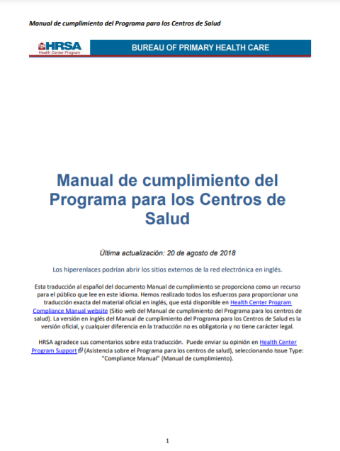

Health Resources and Services Administration (HRSA) Health Center Program
As a condition of receiving an award under the Health Resources and Services Administration and its Health Center Program, health center boards must also follow various requirements of that program found in the Health Center Program Compliance Manual, and Operational Site Visit Protocol which are both available on the HRSA website.
Notes:
Notes: While some new board members may be familiar with the Health Services and Resources Administration (HRSA), it is important for all board members to be aware of the significant role HRSA plays in providing regulatory and compliance guidance for health centers. This slide is meant as a high-level introduction.
Possible talking points:
Under the Health Center Program, Congress appropriates federal dollars for awards to health centers and tasks the U.S. Department of Health and Human Services (HHS) to oversee award-supported activities. Within HHS, the Program is administered by the Health Resources and Services Administration (HRSA) through its Bureau of Primary Health Care (BPHC). Organizations that meet the requirements of the Health Center Program submit an application for funding and, based on availability of funds and an objective review of the application, HRSA may provide an award to help cover the costs of providing health care services in its community.
[For “look-alikes”] Health Center Program “look-alikes” are organizations which do not receive an award but are eligible for other benefits available to Health Center Program awardees. The HRSA website notes: “Look-alikes were established to maximize access to care for medically underserved populations and communities by allowing entities that do not receive Health Center Program funding to apply to become part of the Health Center Program;” more information on look-alikes, including the application process, can be found on the HRSA website.
Additional information about the Health Center Program can be found on the HRSA website (https://bphc.hrsa.gov/about/index.html).

Slide 15
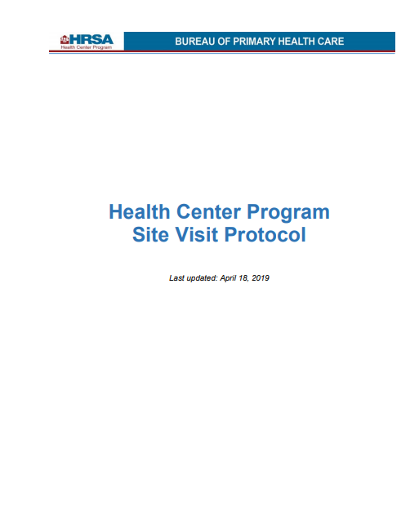
Health Center Governance
Federal Law
State Law
Good Governance Research & Practice
HRSA Health Center Program
Information on good governance can be found in: Governance Guide for Health Center Boards //Guía para las Juntas Directivas del Centro de Salud
https://bphc.hrsa.gov/
© 2021 National Association of Community Health Centers
Notes:
Notes: The point of the slide is to introduce that health center governance is complex.
Potential talking points: Health Center governance is complex. The board as a whole (group) governs the health center and must ensure compliance with:
Federal, state, and local laws
HRSA Health Center Program requirements. The Health Center Program Compliance Manual can be found at https://bphc.hrsa.gov/.
The most effective boards also research and practice good governance. The National Association of Community Health Centers (known as NACHC) has a publication titled the Governance Guide for Health Center Boards that highlights good practice in the context of other requirements. It is also available in Spanish and can be found on the Health Center Resource Clearinghouse at www.healthcenterinfo.org.

Slide 16
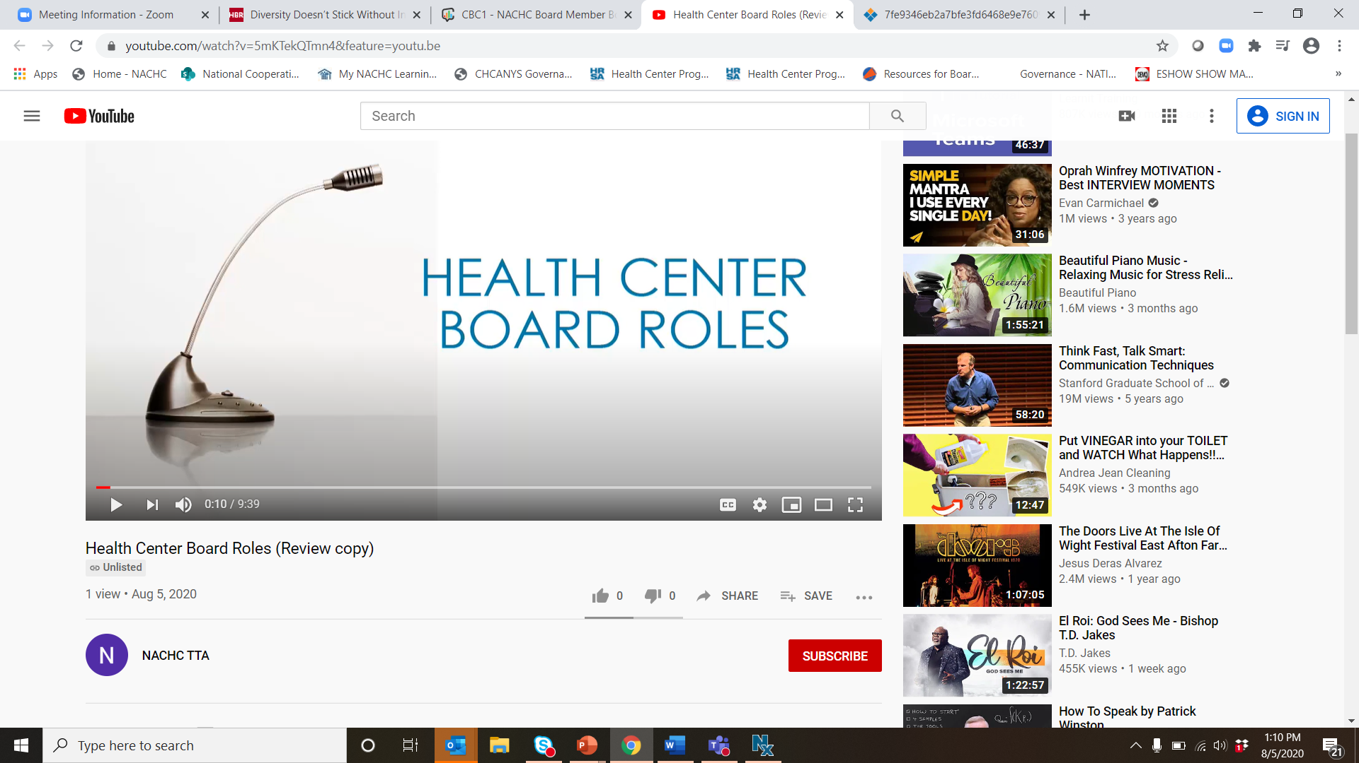
Health Center Board Roles - Video
Video can be accessed at https://www.healthcenterinfo.org/details/?id=2668
Notes:
Notes: Consider sharing a short video from NACHC that addresses health center board roles (available at https://www.healthcenterinfo.org/details/?id=2668) to tee up overall board roles or consider using the following slide instead. The video talks about board roles broadly and puts the requirements of the HRSA Health Center Program in the context of overall board roles.

Slide 17
Overall Board Roles”)
Strategy
Strategic Board Composition
Strategic Planning & Thinking
Functioning
Board Meetings
Board Committees
Board Culture
Oversight & Policy
Approve Policy
Provide Oversight
  CEO Oversight & Partnership
  Financial
  Quality
  Corporate Compliance
  Risk Management
  Health Center Program Compliance
Strategy
Functioning
Oversight & Policy
© 2021 National Association of Community Health Centers
Notes:
Note: Instead of the video, you may instead wish to walk new board members through board roles.
Potential talking points: We can think about board roles in 3 main categories: Strategy, Oversight & Policy, and Functioning. Let’s explore each.
Strategy includes Strategic Board Composition, and Strategic Planning & Thinking:
Strategic Board Composition – The board is responsible for its own size and strategic composition (ensuring the board meets requirements of the Health Center Program and is composed of members that can help the board govern now and in the future), recruiting and vetting board members, electing members, and ensuring board members are oriented and engaged. Boards play a critical role in creating organizations that prioritize and invest in diversity, equity & inclusion.
Strategic Planning and Strategic Thinking – The board approves the health center’s mission, vision, and values; engages in, approves, and provides oversight of the strategic plan; and engages in ongoing strategic thinking in partnership with the CEO.
Effective Board Functioning means that the board ensures its meetings and committee structure (if it opts to have committees) are effective, and that the board has a healthy culture.
Oversight & Policy includes:
Policies – The board approves the organization’s bylaws and other key policies.
CEO Oversight and Partnership – The board hires the CEO, works with the CEO to establish annual performance goals, periodically evaluates the CEO’s performance, approves the compensation of the CEO and the CEO’s contract, and is responsible for partnering with the CEO to ensure day-to-day management is aligned with board-established priorities and policies.
Various Forms of Oversight – The board provides oversight of various areas including financial, quality, corporate compliance, the Health Center Program, and the CEO. The board also assures plans are in place to manage risks faced by the health center.

Slide 18
Health Center Program Compliance Manual
Authorities and Responsibilities of the Board (Chapter 19: Board Authority)
  Hold monthly meetings with quorum
  Selection, approval of and termination (if applicable) of the CEO/ED
  Approval of the health center’s annual budget and applications
  Approval of health center sites, locations, hours of operations
  Performance evaluation of the health center
  Establishing, adopting and evaluating health center policies
  Ensuring health center complies with federal, state and local laws
  Long-range strategic planning at least once every three years (including financial management and capital expenditure needs)
This slide is a high-level summary for training purposes. Please see Chapter 19 of the Health Center Program Compliance Manual for exact language and more details https://bphc.hrsa.gov/programrequirements/compliancemanual/chapter-19.html#titletop.
Notes:
Notes: This slide contains a high-level summary of the requirements in Chapter 19 on Board Authority from the HRSA Health Center Program Compliance Manual. It is important for all board members, and especially new board members, to be familiar with these responsibilities as they are fully enumerated in the Compliance Manual.
Potential talking points: As we alluded to before, HRSA does have various requirements for boards. While it is important to be familiar with the full set of HRSA Health Center Program requirements, we want to start with an overview of Chapter 19 on Board Authority which outlines various authorities and responsibilities a health center board must perform to comply with the HRSA Health Center Program. (Review slide content or consider providing a handout of chapter 19).

Slide 19
Health Center Program Compliance Manual
Chapter 20: Board Composition
  9-25 members
  At least 51% are patients served by the center*
  Non-patient members are representative of the community and selected to provide relevant skills/expertise*
  No more than one-half of non-patient board members derive more than 10% of their annual income from the health care industry*
  Health center employees and immediate family members may not serve
  Include representatives from/for each special population served
This slide is a high-level summary for training purposes. Please see Chapter 20 of the Health Center Program Compliance Manual for exact language and more details https://bphc.hrsa.gov/programrequirements/compliancemanual/chapter-20.html#titletop.
*Additional details and required specificity are included in Chapter 20.
Notes:
Notes: This slide contains a high-level summary of the requirements in Chapter 20 on Board Composition from the HRSA Health Center Program Compliance Manual. Use this as a time to remind new members about the importance of the patient-majority based board model and its importance for the center and the overall health center Movement.
Potential talking points: Additionally, it is important to be aware of the requirements in Chapter 20 on Board Composition of the HRSA Health Center Program requirements. (Review slide content or consider providing a handout of chapter 20).

Slide 20
Governance versus Management - Examples
 | Board /Governance | CEO/Management
Strategic Board Composition | Ensures its own strategic composition, including compliance with requirements of the Health Center Program | Supports board in ensuring its strategic composition, has voice in recruitment
Financial Oversight | Approves budget Monitors financials Oversees audit Approves certain policies | Prepares and proposes budget to board along with key financial staff Manages health center in alignment with financial policies and budget guidelines
Quality Oversight | Approves and revises quality assurance (QA) and quality improvement (QI) policies Ensures follow-up taken regarding quality, patient grievances, etc. | Ensures staff manage the quality program
CEO & Staff | Hires, provides oversight of CEO Establishes CEO compensation Approves certain personnel policies | Hires, manages rest of staff Coaches staff
Excerpt from Governance Guide for Health Center Boards, Chapter 1, p 14.
Notes:
Notes: It is important to also cover the role of the board vs the role of the CEO, who is the only employee of the health center that is selected by the board.
Potential talking points: It has been said that “effective boards understand the difference between governing and managing.” It is important that boards and board members understand the board governs while the CEO is responsible for the overall management of the health center. The CEO is the only employee hired by and overseen by the board and the board delegates the day-to-day operational responsibilities to the CEO. Staff – led by the CEO – manage and implement the priorities and policies set by the board. We can look at Chapter 1, page 14 of the Governance Guide for Health Center Boards for a high-level matrix that shows how governance differs from management (see https://www.healthcenterinfo.org/details/?id=2302).

Slide 21
Individual Board Member –
Legal Duties
Duty of Care
  Acting in good faith with the degree of diligence, care, and skill that prudent people would use in similar circumstances
Duty of Loyalty
  Acting in the best interests of the corporation and avoiding even the appearance of a conflict of interest
Duty of Obedience
  Ensuring that the corporation uses its resources to advance its purpose and goals, and that it complies will all appropriate laws
Notes:
Notes: It’s also important to ensure board members understand their individual legal duties.
Possible talking points: While governance is a group action, it is important for board members to know that there are certain legal duties to fulfill. These include:
Duty of Care – When engaging in health center business, board members must use good judgment and a level of care that an “ordinary prudent person” would exercise in a similar situation under like circumstances. Board members are not expected to know everything about a topic they are asked to consider and may rely on the advice of management and of outside advisors. But board members are legally expected to be aware of what is going on and to make reasonable inquiry so they can act in a manner that they reasonably believe is in the best interests of the health center. Examples of how a board member fulfills the Duty of Care include:
Attend board and committee meetings.
Be prepared for meetings. Read meeting packets completely before attending meetings.
Think independently.
Get all relevant data and information before making a decision or voting to take a specific action.
Duty of Loyalty – This duty prohibits board members from using their board positions to benefit themselves, their immediate family members, or their businesses. It requires that board members place the health center’s needs and interests above all else when making decisions on behalf of the health center. This is demonstrated by being objective and unbiased when making decisions, being free of any conflict of interest when discussing issues or making decisions, and maintaining confidentiality when dealing with health center matters. Examples of how a board member fulfills the Duty of Loyalty include:
Review conflict of interest policies annually.
Require disclosure from candidates for board membership and annually for sitting board members to identify key affiliations, including immediate family members and employers.
Maintain confidentiality about patient and health center business matters at all times.
Duty of Obedience – This duty requires board members to be faithful to the health center’s mission; to follow all state, federal, and local laws; and to abide by board bylaws when representing the interests of the health center. This duty is demonstrated when board members protect limited resources to ensure the maximum benefit to meet the community’s needs. Examples of how a board member fulfills the Duty of Obedience include:
Participate in a comprehensive orientation and understand all documents that pertain to board governance such as bylaws.
Understand the health center’s mission and how it is being achieved by the health center.
Always act in a manner consistent with the health center’s mission, goals, and objectives, as well as the decisions of the board (even if you disagree).
Advance the mission when representing the health center within the community (as authorized).
In today’s context, it is important to acknowledge that the term “obedience” can have many negative connotations and on its surface this term may be confusing when used in relation to board member responsibilities. What is most important to underscore about the intent of this duty is that board members must ensure the organization follows its own mission, policies, priorities, as well as applicable laws.
Each board member must keep the three “duties” front of mind in every interaction. These three duties apply to all decision making, to every action, and to strategic planning. Board members are responsible even if they do not attend meetings regularly or participate in the discussions.

Slide 22
Board Role Description/
Agreement
Sample slide – customize for your center
[insert any board agreement your center might have in place]
Notes:
Notes: Use this slide to review/remind board members of specific expectations (e.g., attend meetings, participate in at least one committee, actively participate, etc.). This may be captured in a list of individual board member responsibilities already adopted by the board. This would be a time to include that information on this slide or in a separate document. The Governance Guide for Health Center Boards (https://www.healthcenterinfo.org/details/?id=2302) contains a sample in Appendix 3 if your board does not currently have this in place.

Slide 23
What to Expect at Board Meetings
Sample slide – customize for your center
Board meetings are [insert current format – e.g., virtual, in-person, hybrid] and last about ____ hours
Quorum is important – your participation is essential
Board packet is available [insert where, how far in advance of meetings] and typically includes [insert description]
Agendas include
  Mission moment or informal discussion
  Consent agenda
  Various reports
  Board education
  Strategic discussion
  Executive session
Notes:
Notes: This slide is intended to help new board members understand what will take place at board meetings. Be sure to orient new members to the importance of quorum (the number of board members with a vote that must be present for a meeting to officially count as a meeting). Be sure to explain consent agendas and executive sessions if your board uses them. Language is below to help if needed:
Consent Agenda – A consent agenda includes items that rarely need discussion such as approval of meeting minutes, the CEO report, and committee reports. All of these items should be sent to and read by board members before the meeting so the board can vote to accept all of the items as a group. If requested, individual items can be pulled out of the consent agenda for discussion.
Executive Sessions – Executive sessions differ from the Executive Committee. Executive sessions are used by boards to discuss matters that are sensitive and strictly confidential. Generally, all staff and visitors are dismissed, with only board members and the CEO remaining. Outside advisors (such as lawyers, auditors, consultants) may be included to issue reports or provide professional guidance. On a limited basis, select senior staff may be included to present a report or provide their perspective. The CEO should not be present when the board discusses the audit or the CEO’s performance review and compensation.
It can also be helpful to describe if your board follows Parliamentary Procedure or a particular approach such as Robert’s Rules of Order. If you are unsure, please see Chapter 9 of the Governance Guide for Health Center Boards (https://www.healthcenterinfo.org/details/?id=2302) and refer to the health center’s bylaws.

Slide 24
Meeting Dates
Sample slide – customize for your center
Board Meeting Dates:
  [insert dates]
Committee Meeting Dates:
  [insert dates]
Notes:
Notes: Depending upon the timing of your orientation session you will want to share when board meetings take place. This should include the full board meeting dates as well as any committee meeting dates the individual has been asked to serve on.

Slide 25
Board Committees
Sample slide – customize for your center
Standing Committees
Executive
Finance
Audit
Governance (or Nominating)
Quality
Fundraising
Board Task Forces or Ad Hoc Committees
Strategic Planning
Notes:
Notes: This slide can be used to introduce the board’s standing committees and their roles, as well as any time-limited task forces or ad hoc committees that may be in place. Standing committees focus on the ongoing governance role of the board. Common committees include Finance, Audit, Governance, and Quality. A Task Force or Ad Hoc Committee is time-limited and may be convened for short projects such as Strategic Planning or CEO Search. (For information on good practices related to standing committees and task forces/ad hoc committees, see Chapter 9 of the Governance Guide for Health Center Boards at https://www.healthcenterinfo.org/details/?id=2302).

Slide 26
Officer Roles
Sample slide – customize for your center
Chair – The chair leads board meetings and provides overall leadership of the board. The chair partners with the CEO to design board meeting agendas and takes the leadership in building a strong partnership with the CEO.
Vice Chair – The vice chair supports the chair and fills in when the chair is unable to carry out duties.
Secretary – The secretary ensures board actions are recorded – which may involve taking minutes or, more likely, reviewing minutes taken by staff, among other duties.
Treasurer – The treasurer chairs the Finance Committee and provides board leadership related to financial oversight.
Notes:
Notes: Use this slide to describe the board’s officers. Customize this based on your board’s structure.

Slide 27
Board Culture and Practices
Sample slide – customize for your center
The board of XYZ Health Center commits to a culture that is:
Focused on the mission and sustainability of the health center
Rooted in role clarity
Inclusive and diverse
Dedicated to active participation and robust dialogue that results in better decision-making on behalf of the health center
The board of XYA Health Center commits to the following ground rules to support the board’s culture:
Contribute actively
Listen attentively
Be fully engaged during meetings
Keep conversations in this room confidential
Notes:
Notes: Use this opportunity to talk about the board’s culture. Culture means “the way we do things around here.” High-performing boards have healthy board cultures that help set the tone for the organization’s culture. This is a place to share the board’s sample culture statement (if it has one) or other board practices/norms. See the Governance Guide for Health Center Boards, Appendix 16 for a sample, and Chapter 9 of the Governance Guide for more information (https://www.healthcenterinfo.org/details/?id=2302).

Slide 28

Questions and Answers
Sample slide – customize for your center
What questions do you have that we can answer now or in the future?
Feel free to email or call us with questions between our sessions!
  [insert Email addresses]
  [insert Phone numbers]
Notes:
Notes: You may encourage participants to ask questions throughout the presentation. This Q&A section opens the door for additional follow-up questions that may arise after the meeting that could be easily answered. This also provides the space that a culture of transparency important for boards. Reassure participants that they will continue to receive all the training and support that they’ll need to fully take on these responsibilities.
If your board has a “board buddy/mentor” program, consider having each buddy/mentor reach out to their mentee after each session to check-in and answer additional questions.

Slide 29
Session 2:
Learning More About the Board’s Oversight Roles
Board Workplan
Health Center Program Compliance
Policy Approval
Conflicts of Interest
CEO Oversight and Partnership
Financial Oversight
Quality Oversight
Risk Management
Corporate Compliance
Questions and Answers
Notes:
Note: This is a sample agenda for the slides as organized in the template. Reorganize the agenda slides – as needed – based on the various agendas at your health center.

Slide 30
Overall Board Roles”)
Strategy
Strategic Board Composition
Strategic Planning & Thinking
Functioning
Board Meetings
Board Committees
Board Culture
Oversight & Policy
Approve Policy
Provide Oversight
  CEO Oversight & Partnership
  Financial
  Quality
  Corporate Compliance
  Risk Management
  Health Center Program Compliance
Strategy
Functioning
Oversight & Policy
© 2021 National Association of Community Health Centers
Notes:
Note: The focus of session 2 – as included in this template – is primarily to provide more information on the oversight and policy-related roles of the board.

Slide 31
Board Workplan or
Calendar
Sample slide – customize for your center
[Insert the board’s work plan if it uses one]
Notes:
Notes: Include the board’s workplan or planning calendar here or as a handout if the board uses such a tool. Help new board members understand this helps the board balance routine items (especially required items by HRSA), strategic issues, and more urgent needs that may arise. See the Governance Guide Health Center Boards, Chapter 10 and Appendix 20 (https://www.healthcenterinfo.org/details/?id=2302) if your board does not currently use a workplan.

Slide 32
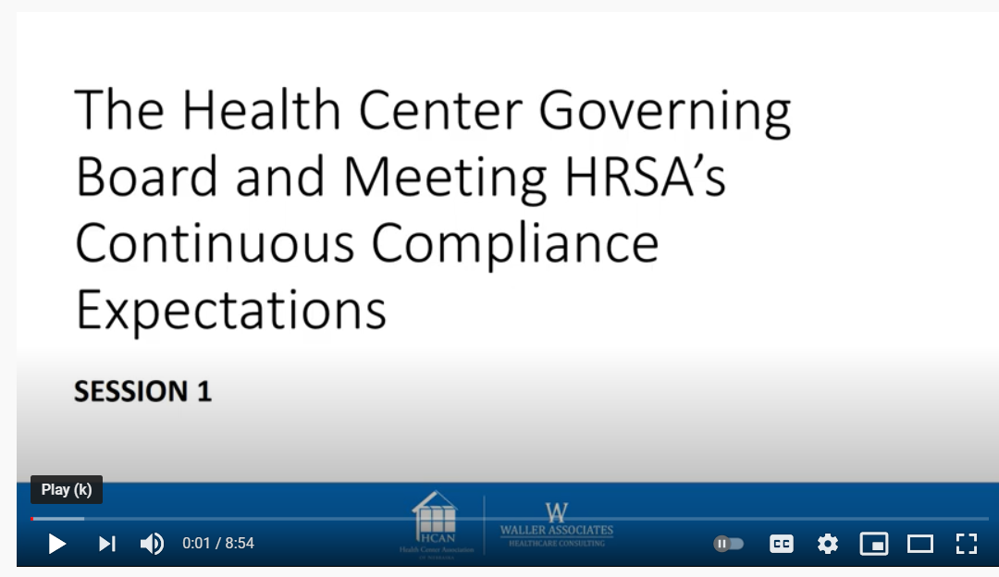
Health Resources and Services Administration (HRSA) Health
Center Program Compliance
Sample slide – customize for your center
Board must ensure compliance with board-focused requirements in the HRSA Health Center Program Compliance Manual
Board participates in Operational Site Visit (OSV) – anticipating next OSV will take place in [insert year]
On-demand Health Center Board Series Focused on Health Center Program Compliance and Related Good Practices (Health Care Association of Nebraska)
Notes:
Notes: Use this slide to remind new members the center must comply with the HRSA Health Center Program. Inform the board about their role in the Operational Site Visit (OSV). Share when the last OSV took place and (generally) when the next one is expected. The Health Care Association of Nebraska also has various videos available that you may wish to show on this topic (or to use for other ongoing board education).
Potential talking points: HRSA conducts periodic site visits of health centers, called Operational Site Visits (OSV), as part of its oversight responsibility under the Health Center Program. HRSA’s Health Center Program Site Visit Protocol (SVP) is the tool used to assess compliance with the Health Center Program requirements during such visits; the SVP establishes a standardized methodology for the OSV that aligns with the Compliance Manual. Various governing documents, such as the bylaws and board meeting minutes are assessed during the OSV and board members participate in interview(s). HRSA’s Site Visit Protocol can be accessed at https://bphc.hrsa.gov/programrequirements/svprotocol.html.

Slide 33
Policy Approval
Sample slide – customize for your center
Bylaws
Various policies
  Conflicts of Interest
  Sliding Fee Discount Program
  Billing and Collections
  Quality Improvement/Assurance
  See the HRSA Health Center Program Compliance Manual for additional policies requiring board review
Notes:
Notes: The board routinely reviews, updates, and approves its bylaws, and various policies including the conflicts of interest policy, and many policies required by the HRSA Health Center Program Compliance Manual. Use this time to review highlights about the center’s bylaws and provide an example of how policies are reviewed and updated by the board.

Slide 34
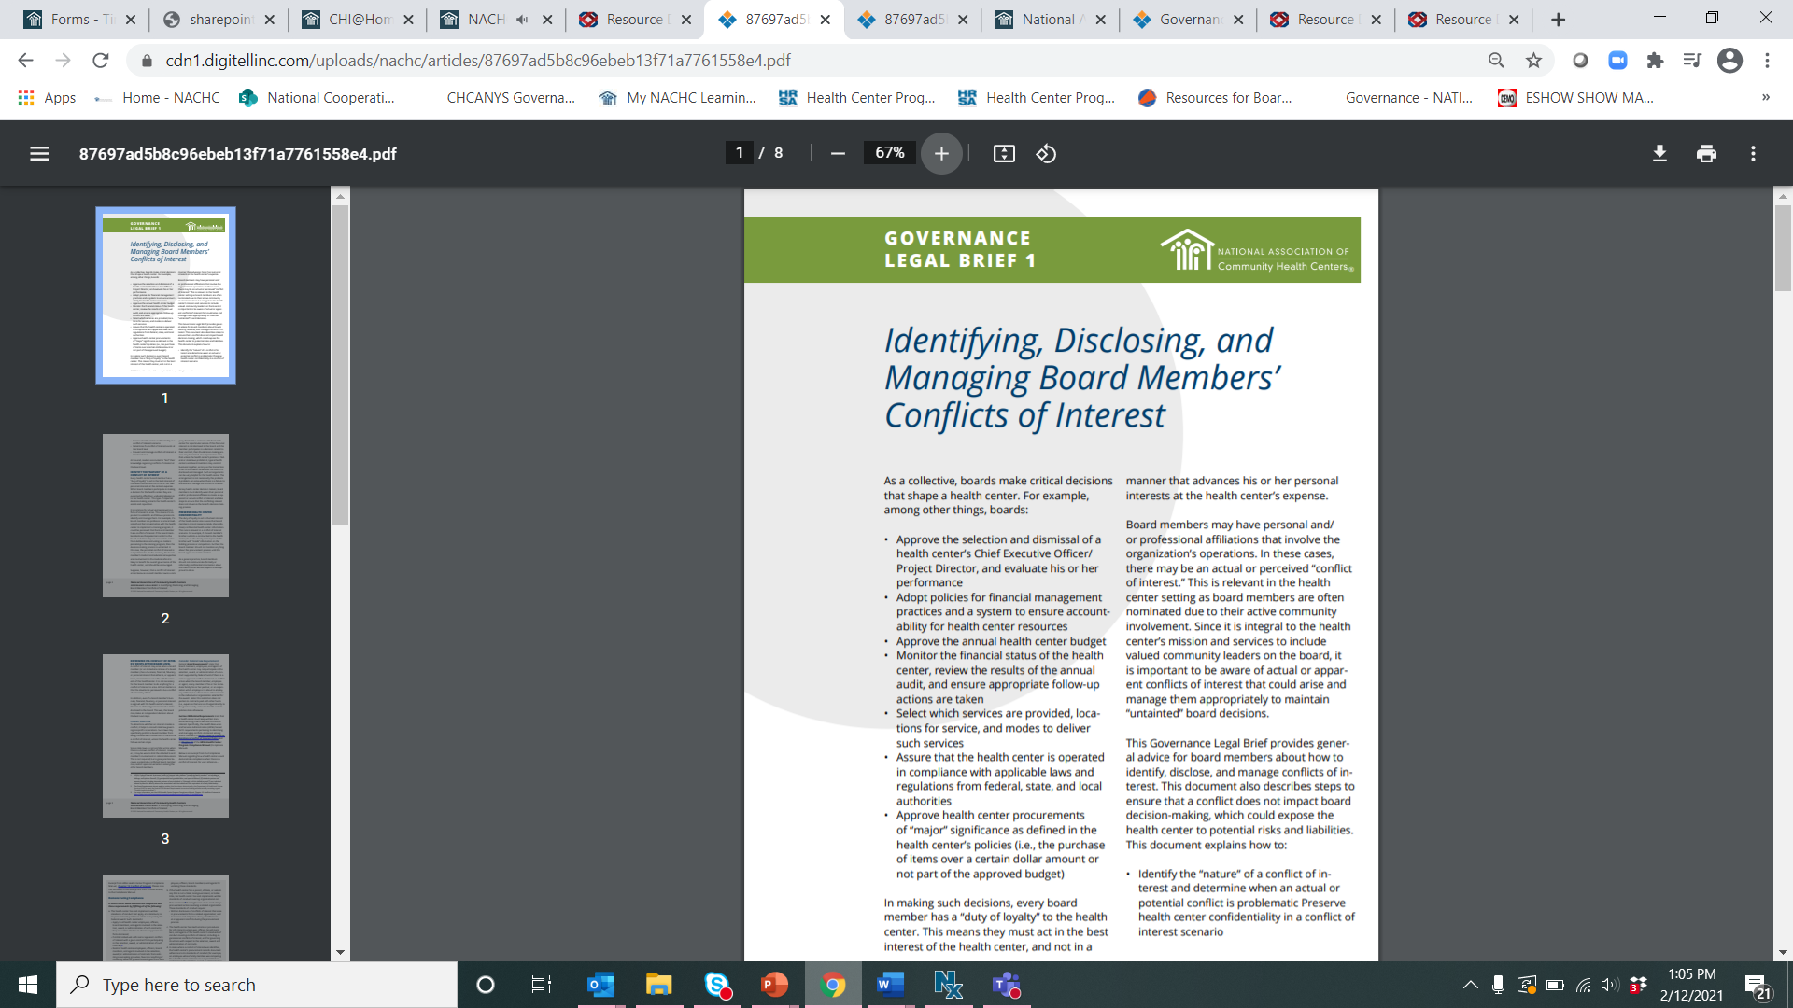
Conflicts of Interest
Sample slide – customize for your center
Complete the annual disclosure form identifying any conflicts of interest
Board process when conflicts arise
  Disclosure
  Discussion
  Management – possible recusal from discussion and voting
  Documentation
Identifying, Disclosing, and Managing Board Members’ Conflicts of Interest (Governance Legal Brief 1)
https://www.healthcenterinfo.org/details/?id=2866
Notes:
Notes: It is important new board members know to disclose conflicts of interests (on the center’s disclosure form) and how to disclose and manage them. Review the center’s procedures. For additional reading, consider using NACHC’s “Identifying, Disclosing, and Managing Board Members’ Conflicts of Interest (Governance Legal Brief 1)” at https://www.healthcenterinfo.org/details/?id=2866 which includes some possible case studies as well for discussion.

Slide 35
CEO Oversight and Partnership
Sample slide – customize for your center
The CEO is the only employee who is selected by the board
The board works with the CEO to
  establish annual performance goals
  provide a routine evaluation of CEO performance [insert timeframe]
  approve the CEO’s compensation (in compliance with IRS requirements, note: the CEO’s compensation is public information on the IRS Form 990)
  approve the CEO’s contract
  ensure an emergency succession plan and succession policy are in place
The board and CEO have a partnership based on mutual respect, trust, open communication, and shared strategic priorities
Notes:
Notes: Use this slide to talk more about how the board both provides oversight of the CEO and how the board and CEO partner together in support of the health center. Consider providing dates of when major events take place (e.g., month of the CEO’s evaluation) and talk a little bit about what to expect during that process.
Potential talking points: The CEO, who may be called the Executive Director or “Project Director,” is the only employee who is selected by the board. The board should work with the CEO to establish annual performance goals and provides a routine evaluation of CEO performance. It is also good governance practice for the board to approve the compensation of the CEO – and the Internal Revenue Service (IRS) asks specific questions about the process for determining such compensation on the Form 990 (discussed below) - as well as to undertake CEO succession planning (which includes approving an emergency succession plan and succession policy).
Ideally, the board and CEO have a strong partnership as neither can do its job effectively without the support of the other. Having trust and open communication are critical for ensuring that issues at the health center are being managed effectively.
The CEO is responsible for hiring and oversight of the health center’s staff. Senior staff members often attend board meetings and/or are designated by the CEO to serve as the staff liaison for a board committee. It is important that both board and staff understand parameters for appropriate board-staff communication. Additionally, it is critical for board members to understand that communication and requests of the Center staff should go through and be approved by the CEO in advance so that the CEO can determine the timing of the priority.

Slide 36
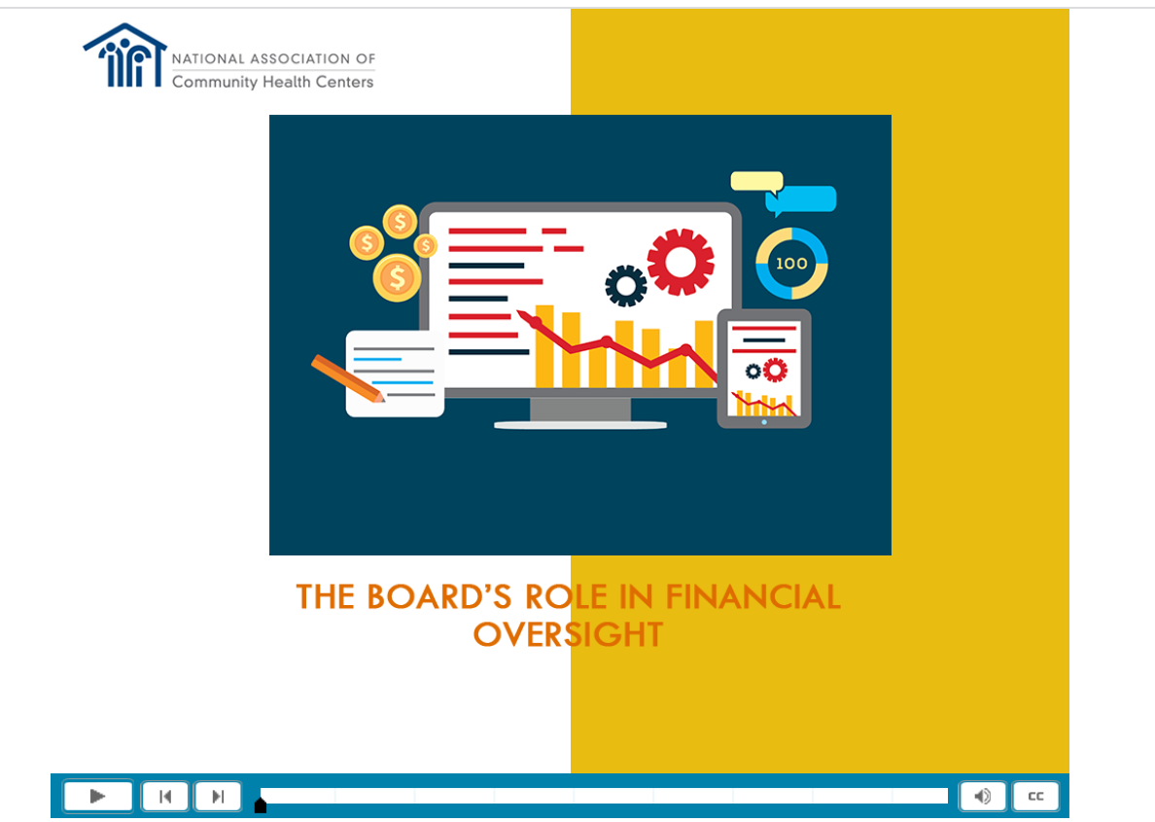
Financial Oversight
Modules on Board Financial Oversight -- Module 1: The Board's Role in Financial Oversight
English: https://www.healthcenterinfo.org/details/?id=2152
Spanish: https://www.healthcenterinfo.org/details/?id=3048
Notes:
Notes: This is a place to talk in more detail about how the board provides financial oversight. As one option, consider showing Module 1: The Board’s Role in Financial Oversight. Alternatively, there are some general talking points below.
Potential talking points: Board members are stewards of the health center’s finances and must act with care to avoid harm to the health center and the investment of public dollars in the organization. Sometimes board members assume that ensuring financial health is the responsibility of the CEO and the CFO and/or the treasurer and Finance Committee. However, that assumption is not correct.
By learning the basics of health center finance, board members can provide proper oversight to ensure the health center’s future.
The board must approve the center’s budgets, monitor financial reports on a regular basis, approve various financial policies, hire the auditor and approve the audit, and approve the center’s IRS Form 990.

Slide 37
Budget
Financial Oversight
Sample slide – customize for your center
Current Budget:
Major source of Income:
  [insert]
Major Expenses:
  [insert]
Fiscal Year:
Notes:
Notes: Consider providing some budget highlights on this slide and reviewing the budget with participants.
Potential talking points: The board is responsible for reviewing and approving the annual organizational operating budget, which is the health center’s financial plan for achieving its health service program and financial goals. It is important that the budget aligns with the overall priorities and strategic plan for the center.
The health center’s operating budget must be approved by the board; it should also be reviewed throughout the year and adjusted, as necessary, by the center’s management and the board.
In reviewing and approving the budget, a board considers items such as the current year’s expected results, anticipated changes in funding, changes in expenses, as well as provider vacancies and anticipated changes in patient volumes.

Slide 38
Monitoring Financial Performance
Financial Oversight
Balance Sheet (also called Statement of Financial Position)
lists assets and liabilities
Income Statement (also called Statement of Activities or Statement of Operations)
identifies revenue and expenses over a period
Cash Flow Statement
records the amounts of cash entering and leaving
provides snapshot of the health center’s financial health at a particular time
includes comparison to budgets amounts and to actual results for the same period in the previous year
if income is higher than expenses, there is a profit; if less, there is a loss
if the bottom line is positive, the organization has on-hand cash or liquid assets, meaning it can quickly sell assets to get cash
Source: Governance Guide for Health Center Boards //Guía para las Juntas Directivas del Centro de Salud
(National Association of Community Health Centers)
Notes:
Notes: This slide orients new members to the types of financial statements monitored by the board. The next slide contains various modules that provide a deeper dive overview of each. Consider whether a deeper dive, additional session should be dedicated to looking more closely at and understanding financial statements. Also consider walking through your center’s financial statements (by providing additional documents or inserting examples of the center’s financial statements on forthcoming slides).
Potential general talking points: The board is responsible for ongoing monitoring of the center's financial status through regular review of the balance sheet, income statement, and cash flow statement, as well as assessment of other financial performance measures. Boards review this information together to get an overall “picture” of the center’s financial position.

Slide 39
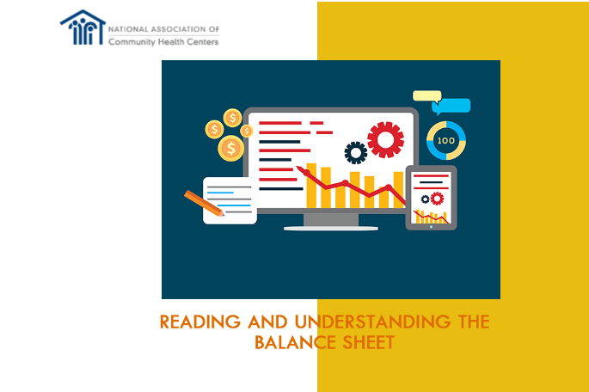
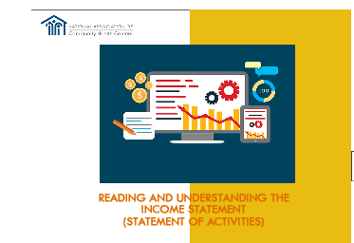
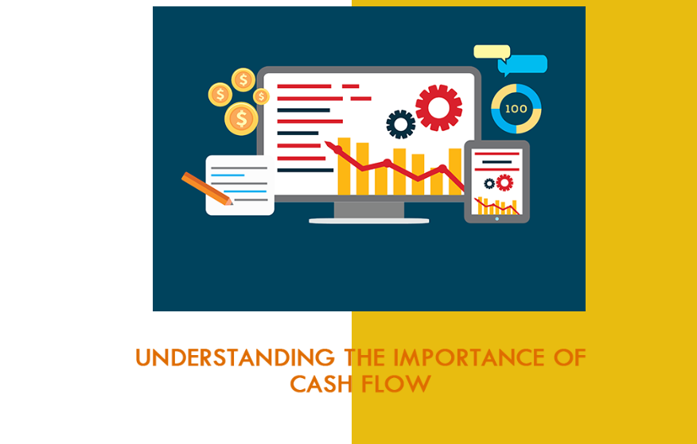
Monitoring Financial Performance
Financial Oversight
Modules on Board Financial Oversight –
Module 2: Reading and Understanding the Balance Sheet (Statement of Financial Position)
Module 3: Reading and Understanding the Income Statement (Statement of Activities)
Module 4: Understanding the Importance of Cash Flow
English Modules https://www.healthcenterinfo.org/details/?id=2152
Spanish Modules: https://www.healthcenterinfo.org/details/?id=3048
Notes:
Notes: Various modules are available to help new board members understand common financial statements. You may incorporate in this – or other trainings – or encourage new members to review these on their own time.

Slide 40
Statement of Financial Position (Balance Sheet)
Sample slide – customize for your center
Notes:
Notes: Consider inserting the center’s balance sheet here and discussing it and/or taking a deeper dive on this financial statement.
Potential general talking points: The Balance Sheet lists the assets (what the health center owns -- usually cash, grants receivables, patient accounts receivables, equipment and property owned by the health center) and liabilities (what the center owes or debts such as a line of credit or a building mortgage). It provides a snapshot of the health center’s financial health at a particular point in time.

Slide 41
Statement of Activities (Income Statement)
Sample slide – customize for your center
Notes:
Notes: Consider inserting the center’s income statement here and discussing it and/or taking a deeper dive on this financial statement.
Potential general talking points: The Income Statement identifies revenue and expenses over a period of time. The report should include comparison to budgets amounts and to actual results for the same time period in the previous year. If income is higher than expenses, there is a profit; if less, there is a loss.

Slide 42
Statement of Cash Flows
Sample slide – customize for your center
Notes:
Notes: Consider inserting the center’s statement of cash flows here and discussing it and/or taking a deeper dive on this financial statement.
Potential general talking points: The Cash Flow Statement records the amounts of cash entering such as payment for services (shown as a positive number) and cash leaving the health center such as payment for salaries (shown as a negative number). If the bottom line is positive, the organization has on-hand cash or liquid assets, meaning it can quickly sell assets to get cash.

Slide 43
Financial Ratios
Financial Oversight
Measure Name | What it measures
Operating Margin | Measures the performance of the health center over a period of time, and is calculated by dividing operating income by total revenues.
Days Cash on Hand | Measures how many days a health center can pay its expenses if income were to cease.
Unrestricted Net Assets | Total unrestricted net assets less net investment in fixed assets
Current Ratio | Current assets divided by current liabilities
Days in Accounts Receivable | Measures how long it takes for a health center to collect its patient accounts receivable.
Days in Accounts Payable | Measures the days that a health center takes to pay its vendors.
Notes:
Notes: Use this to familiarize new members with various financial ratios a board may review.
Potential talking points: A ratio is a way to express the relationship between one measure to another. When looked at over a period of time, financial ratios are useful to assess an organization’s financial situation – whether the financial picture is getting better or worse. Various financial viability/cost measures are also required by HRSA including Total cost per patient, Medical cost per medical visit, Health Center Program grant costs per patient.

Slide 44
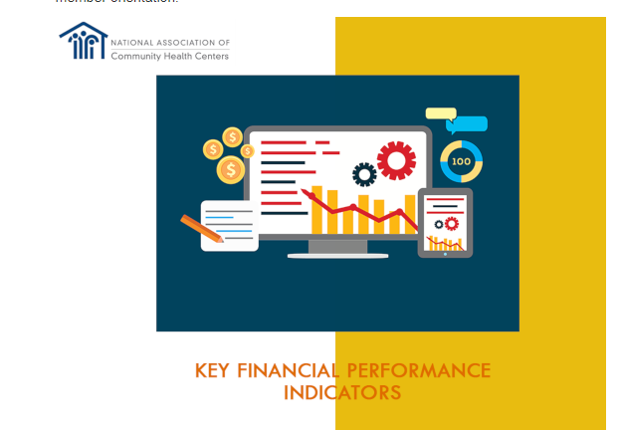
Financial Ratios
Financial Oversight
Sample slide – customize for your center
[Insert information on your board’s KPIs]
Modules on Board Financial Oversight –
Module 5: Key Financial Performance Indicators
English Modules:
https://www.healthcenterinfo.org/details/?id=2152
Spanish Modules: https://www.healthcenterinfo.org/details/?id=3048
Notes:
Notes: Use this time to discuss ratios your board looks at and provide a current dashboard or report. A module is available to help new board members understand common financial statements. You may incorporate in this – or other trainings – or encourage new members to review these on their own time.

Slide 45
Audit
Financial Oversight
Sample slide – customize for your center
IRS Form 990
Notes:
Notes: Use this to talk about the board’s role related to audit and the IRS Form 990. Consider sharing the health center’s most recent of each.
Potential talking points: The audit is an essential step to validate information found in the center’s financial statements. Health centers are required to engage an audit firm to perform an annual, independent audit in accordance with federal audit requirements. The board’s role in the audit is to: select the auditor, who must perform the audit in compliance with Federal requirements; review the audit; ask questions of the auditor; and approve the audit. If there are findings or material weakness, the board is responsible for ensuring that the CEO and staff develop and implement a corrective action plan.
The Internal Revenue Services (IRS) requires that most federally tax-exempt organizations annually file the IRS Form 990. Form 990 provides information that allows the IRS to determine whether or not an organization continues to fill the requirements for its tax-exempt status. Specific oversight of the completion of Form 990 is generally the responsibility of the board's finance committee or audit committee, however the Form includes questions related to the entire governing board. The board typically reviews the Form 990 prior to it being filed by the health center.

Slide 46
Quality Oversight
Just like financial performance, the board is responsible for the oversight of the quality, safety, service, and access to care.
The board:
  Sets the tone about the importance of quality
  Approves various QI/QA policies
  Frequently reviews quality data, discusses benchmarks and corrective action, if warranted
  Ensures follow up actions are taken and documented in board minutes
  Plays a role in provider credentialing and privileging
Notes:
Notes: Use this slide to provide a deeper overview of the board’s role regarding quality oversight.
Potential talking points: Providing quality healthcare services is central to improving the health of patients and the community. Achieving improved community and patient health involves paying attention to quality measures and improving the excellence of patient care and organizational operations. The board:
Approves and periodically updates QA/QI policies that address items such as:
‒ The quality and utilization of health center services,
‒ Patient satisfaction and patient grievance processes,
‒ Patient safety, including adverse events.
Monitors quality and safety indicators and the progress to achieve performance goals. Using dashboards can be a helpful tool for monitoring metrics.
Puts patient safety and quality on the board’s meeting agenda frequently (e.g., monthly, every 2 months).
Reviews quality measures, discuss benchmarks, and discuss corrective action plans for poor quality or adverse events.
Ensures appropriate follow-up actions are taken and includes discussion of follow up actions in board meeting minutes.
Discusses quality and safety standards related to staff and facilities in addition to services.
[Adapt this for what role your board plays] It is no longer a requirement of the Health Center Program that the board must have authority to approve each practitioner’s credentials and to award or deny privileges to the practitioner. However, a board may still want to consider what role it wants to play in this process. For example, the board may wish to consider keeping this practice as-is, as many boards of health care delivery organizations consider this to be a good and important practice. In addition to or alternatively, the board may opt to approve a credentialing and privileging policy periodically (e.g., every 3 years).

Slide 47
Quality Oversight
Sample slide – customize for your center
[Insert or use this time to review a Quality report and talk about the data]
Notes:
Notes: Use this slide or time to review a recent Quality report and talk to new board members about some of the data the board reviews.

Slide 48
Risk Management
Regular review and approval of the health center’s risk management program
Federal Tort Claims Act (FTCA) Coverage
  According to the HRSA website, the Federal Tort Claims Act (FTCA), established in 1946, is the legal mechanism for compensating people who have suffered personal injury due to the negligent or wrongful action of employees of the U.S. government.
  Board hears annual risk management update
  Keeps QI/QA policies updated
  Hears regular reports, documented in minutes
Notes:
Notes: Use this to review the board’s role related to Risk Management.
Possible talking points: A risk management program protects the health center’s assets by having a structured system and procedures in place to reduce risks that may result in loss, such as the loss of financial resources or staff time. Risks may be related to many areas including medical malpractice, noncompliance with federal and state laws and regulations, safety of patients and employees, or charges by staff of discrimination and harassment. Examples of how a board may fulfill its risk management oversight responsibility include:
If FTCA deemed, ensure compliance with requirements for the deeming application, requirements associated with the Operational Site Visit, and, as appropriate, with the requirements of the FTCA Site Visit Protocol. This may include, for example, undertaking risk management activities associated with the FTCA (discussed above) including ensuring the board annually hears a report on health care risk management activities, keeps quality improvement/quality assurance policies updated, hears reports on QI/QA, and maintains board meeting minutes that demonstrate this activity.
Review and approve the health center’s risk management program; the program may include risk assessment protocols and steps to manage or eliminate risks such as having the facility inspected at least annually for fire and safety risks and having an independent review of the health center’s insurance coverage.
Assure effective communication by establishing a system for staff (a designated point person -- the “Risk Manager”) to report to the board about the risk management program and progress for improvement and for the board to communicate with the CEO about key expectations.

Slide 49
Risk Management
Sample slide – customize for your center
[Insert or use this time to review a Risk Management plan and talk about the data]
Notes:
Notes: Use this slide or time to review the Risk Management plan.

Slide 50
Corporate Compliance
Sample slide – customize for your center
Compliance Officer Name: ________________
[Describe frequency with which Compliance Officer reports to the board]
Notes:
Notes: Introduce the center’s corporate compliance program and the board’s role.
Talking points: With the implementation of the Affordable Care Act (health care reform), health centers and other health care providers are required to implement a corporate compliance program as a condition of enrollment in Medicare, Medicaid, and the Children’s Health Insurance Program (CHIP). The implementation of a robust compliance program helps assure that the board is meeting its obligation under Section 330‘s implementing regulations to ensure that the health center is operating in compliance with applicable Federal, state, and local laws. There are various elements that must be in place in a compliance program including:
Designate a compliance officer/contact.
Conduct internal monitoring and audits.
Develop written standards and policies to implement the Compliance Program and govern health center operations.
Conduct culturally and linguistically competent training and education programs.
Develop effective, clear, open lines of communication between compliance and health center personnel -open door policy and policy prohibiting retaliation.
Investigate detected problems and develop corrective action.
Publicize and enforce disciplinary standards.

Slide 51
Questions and Answers
Sample slide – customize for your center
What questions do you have that we can answer now or in the future?
Feel free to email or call us with questions between our sessions!
  [insert Email addresses]
  [insert Phone numbers]
Notes:
Notes: You may find that participants ask questions throughout the presentation. This Q&A section opens the door for follow-up questions that may arise after the meeting that could be easily answered in the interim. This also provides the space that a culture of inquiry and transparency important for boards.
If your board has a “board buddy/mentor” program, consider having each buddy/mentor reach out to their mentee after each session to check-in and answer additional questions.

Slide 52
Session 3:
Learning More about Healthcare and Key Issues
Strategic Plan
Additional issues impacting the Center’s internal and external environment
COVID-19 impact on our Health Center
Strategic Thinking and Discussion
Notes:
Note: This is a sample agenda for the slides as organized in the template. Reorganize the agenda slides – as needed – based on the various agendas at your health center. Even though this section does not have as many slides, use the time to provide background on important topics for your center and its governance.

Slide 53
Strategic Plan
Sample slide – customize for your center
Current plan developed in ____________ and most recently updated in __________
The current plan was informed by a community needs assessment conducted in _______
Plan includes
  [insert priorities]
The board [insert how the board provides oversight – e.g., receives quarterly updates, reviews a dashboard of progress, etc.]
Notes:
Notes: Strategic planning is the board and management team’s attempt to create the health center’s future, achieve its vision, advance its mission, and exert some influence over an uncertain future. It is both a good governance practice to have a strategic plan in place, as well as a requirement of the Health Center Program. Use this slide to provide background on the health center’s current strategic plan, being sure to outline board involvement in the planning process and in oversight of plan implementation.

Slide 54
Internal or External Issues Impacting Our Health Center
Sample slide – customize for your center
Internal
  Recruitment and retention
  Training
  Workforce Development
  Funding Resources
  Need for new strategic vision
  [insert issues relevant to your center]
External
  Value Based Payments/Accountable Care Organizations (ACO)
  340B
  Social Justice Issues
  COVID-19
  [insert issues relevant to your center]
Notes:
Notes: Use this slide to provide a list of other internal or external issues impacting the center. One example might be ensuring new members understand the transition from “volume” to “value.” A publication is available from NACHC for board members on this topic (Payment Reform Fundamentals for Health Center Boards, https://conferences.nachc.org/nachc/articles/163/view).

Slide 55
COVID-19 and Impact on our Health Center
Sample slide – customize for your center
[Insert items relevant to governance regarding the impact of the pandemic on the health center that new board members should be aware of; this might include:
  any shift to telemedicine;
  changes to operating environment to improve patient safety;
  change in operating hours;
  staff retention strategies;
  COVID testing protocols for both staff and patients;
  COVID vaccination strategies for both staff and patients]
Notes:
Notes: This section could include a timeline of significant events and board decisions along with impact. Note: NACHC has a series of articles that discuss how various components of health center governance were impacted by the pandemic available at https://www.healthcenterinfo.org/priority-topics/covid-19/covid-19-resources-governance/.

Slide 56
Board Discussion about Strategic Issues
Sample slide – customize for your center
[insert recent strategic discussion topics or issues anticipated in coming board meetings]
Notes:
Note: Strategic questions guide the organization from current to future state in partnership with the CEO. While a board often engages in this during strategic planning, it is not reserved solely for that process. The pandemic, for example, presented a need ask strategic questions on an ongoing basis – for example: What business model makes sense for our patients (In-person vs telehealth etc.)? What role will telehealth play in the mid- to long-term future for our center? Do we need to assess our sites and how we serve patients? Generative questions are posed when the board thinks about the future and tackles questions core to its mission, vision, and values such as: Has the pandemic impacted the mission and vision of the center? Answers to generative questions often help shape fiduciary oversight and health center strategy.
This provides an opportunity to discuss how your board engages on strategic thinking and robust discussion on a routine basis. The slide may tee up discussions coming soon to help familiarize new members.

Slide 57
Other topics
Sample slide – customize for your center
Fundraising
  [Insert short overview of the board’s role in fundraising, if any]
Advocacy
  [Insert short overview of the board’s role in fundraising, if any]
Notes:
Note: This slides to cover the board’s role in fundraising, advocacy, and other areas as appropriate for your board. For example, does the board participate in allowable advocacy? How? Does the board raise funds or does the center have an associated foundation? What do new board members need to know?

Slide 58
Questions and Answers
Sample slide – customize for your center
What questions do you have that we can answer now or in the future?
Feel free to email or call us with questions between our sessions!
  [insert Email addresses]
  [insert Phone numbers]
Notes:
Notes: You may find that participants ask questions throughout the presentation. This Q&A section opens the door for follow-up questions that may arise after the meeting that could be easily answered in the interim. This also provides the space that a culture of inquiry and transparency important for boards.
If your board has a “board buddy/mentor” program, consider having each buddy/mentor reach out to their mentee after each session to check-in and answer additional questions.

Slide 59
Continue the Learning
Governance Guide for Health Center Boards //Guía para las Juntas Directivas del Centro de Salud
(National Association of Community Health Centers)
On-demand Health Center Board Series Focused on Health Center Program Compliance and Related Good Practices (Health Care Association of Nebraska)
ADDITIONAL GOVERNANCE RESOURCES
https://www.healthcenterinfo.org/quick-finds-governance/
Notes:
Notes: You may want to encourage board members to learn more about overall board roles by reading parts of NACHC’s Governance Guide for Health Center Boards (https://www.healthcenterinfo.org/details/?id=2302). You may also want to incorporate more about Health Center Program Compliance and the Operational Site visit; the Primary Care Association of Nebraska has a multi-part video series available to boards (https://www.healthcenterinfo.org/details/?id=2912). Additionally, the Health Center Resource Clearinghouse contains a robust library of additional toolkits, articles, videos and modules to support health center boards.

Slide 60

This product was developed by the National Association of Community Health Centers thanks to a generous grant from the Pfizer Foundation.
Please contact
trainings@nachc.org with questions.

