Slide 1
Virtual Enrollment Workflow
This series of slides depicts a virtual enrollment workflow.
Each slide is accompanied by a checklist.
This tool can be used to facilitate discussion with your staff about internal and external processes.
Outreach & In-Reach
Pre-screening & Preparation
Appointment
After the Appointment Follow-Up
Post-Enrollment Follow-Up
Notes:
As mentioned, this prescreening checklist serves as a baseline of questions to ask the consumer before the appointment to ensure that you have a good picture of what they may need coming into the appointment.

Slide 2
Engage Partners with an Online Presence
In-Reach
Telephone reminders & texting Polling interest in enrollment with self-pay, walk-ins
Faith-Based Church Meetings
Schools, Community
Colleges
Virtual Enrollment: Outreach
In-Reach
Social Media
Earned Media
Facebook Live Q&A Instagram TV Tweets about how to get help enrolling
OpEds Radio interviews Information-based telethons
Notes:
During COVID-19 outreach and enrollment is going to look a little different, mostly in that what both assisters (CACs and Navigators) and consumers are used to in-person has transitioned to virtual or remote outreach and enrollment. Virtual outreach can be done in a variety of ways to engage consumers, just as they would in-person.
Partners can still be involved through online events such as FaceBook live videos to engage consumers, or virtual town halls, whether that’s with elected officials, or faith-based organizations and schools.
Social media campaigns are a tried-and-true method of engaging the consumers. Apps that can send text messages to consumers about enrollment can keep the drumbeat going virtually as many of these digital technology platforms offer free trials that are may be useful to try during this time.
Earned media is still critical when reaching consumers because it’s free for you and doing press interviews, or sharing client stories is a great way to get the word out because stories are relatable. Using newspaper, articles, radio segments, and information-based telethons at local news outlets are all useful ways to get your message out there.
Outreach still needs to be year-round because people also qualify for special enrollment periods throughout the year.
In-reach is equally as important as outreach by creating internal referral pathways and training staff about the importance of patients having coverage to ensure health centers have a payor mix (e.g. Medicaid, marketplace coverage) within your health centers, too.

Slide 3
1
5
Consumer connects
via phone, referral
or in-person
Schedule & confirm
appointment
Virtual Enrollment:
Pre-screening & Preparation
2
4
Ask pre-screening questions
Ensure the consumer knows that this appointment is about health insurance coverage options
3
When did you last have coverage? What County do you reside in? Do you have access to your email?
Assist the consumer in creating and accessing their marketplace account
Notes:
Pre-screening and preparation are the first of the four steps in the virtual enrollment cycle when working remotely. Arguably one of the most important steps, this gives you time to help triage the conversation and make sure the consumer is getting tailored help from start to finish, increasing your efficiency and their satisfaction.
Prescreening questions can be found in the prescreening checklist later in the workflow but provide a quick and easy guide to help get the appointment started.
Setting expectations with the consumer about what they are going to get from you, as well as what you are going to need from them is imperative to help level set what is going to happen during the appointment and preemptively clear up questions they might have about the process.
The final step in prescreening and prep is to schedule and confirm the appointment and move to the marketplace and the application when you they are ready.

Slide 4
Virtual Enrollment:
Pre-screening Checklist
Do you currently have coverage?
When was the last time you had coverage?
What is your household size?
What is your annual income?
What county do you currently live in?
Would you prefer a video or phone appointment?
Do you have access to your email?
Notes:
As mentioned, this prescreening checklist serves as a baseline of questions to ask the consumer before the appointment to ensure that you have a good picture of what they may need coming into the appointment.

Slide 5
1
7
Initiate enrollment appointment by phone or video call
Select plan, complete application and enroll into coverage
2
6
Obtain consent
Virtual Enrollment:
Appointment
Regulations vary by state
Marketplace will determine coverage options that match consumer qualifications
3
5
Collect household financial and coverage information
4
Review SEP available if outside of Open Enrollment
Check to see if doctors, hospitals, and pharmacy still in-network
Verify income

Slide 6
1
5
Schedule follow-up appointment
Virtual enrollment may need more follow-up than in-person
Schedule
post-enrollment
follow-up
Virtual Enrollment:
After the Appointment
Follow-Up
2
4
Answer any remaining questions
Shred all physical documents containing PHI & PII
3
Ask Consumer to keep their records in a safe place for reference
After appointment ends, wipe all PII, PHI from electronic devices (this can be done remotely)
Notes:
Often times enrollment appointments require more than one “touch” virtually or in-person. Virtual appointments can take longer to get set up, there can be technology gaps and time lags, an overall lack of familiarity with technology can also present challenges which require spiltting up the appointments to be more manageable for the consumer and assister. Virtual enrollments may require several follow-ups.
Between the end of the appointment and follow-up, pending there are no issues from the marketplace application process, make sure follow-up with a quick email or phone call to confirm the consumer was able to enroll. If there were issues, setting reminder to contact the consumer about uploading any outstanding documents or setting up a follow-up appointment to go over these issues as the next step.
Answer any remaining questions the consumer might have from their initial appointment and make sure the consumer understands and is encouraged to return to the health center for questions about their coverage. This is important to emphasize to ensure the patient returns and you answer any health insurance literacy questions they might have about their plan.
After the appointment ends, wipe all PHI from the computer, phones or any additional technology that you used during the appointment, and shred any physical documents that contain protected health information (PHI) or personally identifiable information (PII). These wipes must occur to ensure HIPAA compliance and adhere to privacy laws.
Schedule a follow-up appointment to find out the consumer is enrolled (or “effectuated” which means they have paid their premium and their coverage is now active) and whether s/he knows to pay their monthly premium (if they have one) and understands any out of pocket costs. You also want to resolve questions about their coverage that they have at that point.

Slide 7
Virtual Enrollment:
Follow-Up Checklist
Did you upload required documents?
Did you get your health insurance cards in the mail?
Do you have any additional questions?
Do you need to schedule a follow-up appointment?
Any other state-specific questions required.
Notes:
Probing questions for the consumer may help lead them to ask questions of their own that they might not have originally, did they upload the required documents? Perhaps they were unsure of the process, did they get their health insurance cards in the mail? These questions are important to know in case the answer to any one of them is no, the consumer might not think to reach back out, so asking preemptively in a follow-up ensures that they don’t slip through the cracks.

Slide 8
1
Enrollment Cycle Complete until Renewal
Connect with the consumer
post-enrollment
Renewing coverage requires reviewing plan options all over again due to changes each year
Virtual Enrollment:
Post-Enrollment Follow-Up
2
4
Answer any remaining questions they have about their coverage
3
Educate on where to find plan details & resources
24-hour hotlines Nurse lines Urgent Care
Health Insurance Literacy: Explain the basics of their coverage
Notes:
Connecting with the consumer after your appointment and after their coverage is active, or effectuated, provides an opportunity to explain any health insurance concepts about their coverage that may be murky, especially as the language of health and health care can be confusing.
Use this time to explain and repeat any past explanations of the basics of their coverage. Point out important details like customer service lines, nurse hotlines, and phone numbers to their doctor’s office. Follow-up checklists for both appointment and post-enrollment follow-up can be found in the next slides.
Once you have checked in the with the consumer after their coverage has been effectuated, the enrollment cycle is complete! As you can see, enrollment is not a “one and done” effort.
It’s no easy task to enroll into coverage, which is why outreach and enrollment assistance remains as crucial as ever. With confusing media reports, contradictory regulations, there may be more people changing insurance or purchasing for the first time and assisters are uniquely positioned to help people find the right coverage for their needs.

Slide 9
Virtual Post-Enrollment Follow-Up Checklist
Were you able to pay your first premium?
Are your doctors still in-network?
Is your preferred hospital still in-network?
Do you have all of the important numbers?
Plan networks can change
Health Plan, Urgent Care, Nurses Hotline, Doctor’s Office, Dentist’s Office, Pharmacy, etc.
Notes:
After the consumer’s coverage is active, these final questions are aimed at health insurance literacy and making sure the consumer is fully aware of the basics of how to pay for their coverage, what numbers they should call and when, and making sure what they started out with in the beginning of this process, like their doctors’ network, their preferred hospital, still works with their choice of coverage.
The importance of asking the consumer whether their doctors and preferred hospital is still in network is due to the ability of plans and doctors to renegotiate networks at any point in the year, while the consumer must remain in their plan until the renewal or Open Enrollment period. Bearing that in mind, asking the consumer about this is important to know, as their doctor and/or hospital might not be in-network anymore and they will want help finding new options in the following open enrollment period.

Slide 10
Red Flags & Caveats
Notes:
There are a number of small things to consider when going through the virtual enrollment workflow. These tips are meant to serve as helpful ideas and reminder on how to keep the appointments on track and make sure that you are answering all of the consumer’s questions in a manner that complies with both federal and state regulation, as well as protecting both of your personal information.
Signing on early to make sure that your equipment is functioning properly is an easy way to make prescreening and prep a quick step in the virtual enrollment workflow. This allows adequate time for you to troubleshoot any potential issues from Wi-Fi to camera or phone connectivity so that you don’t get bogged down during your appointment.
Using the pre-screening questions to triage what the consumer needs and develop some preliminary pathways or ideas helps sketch out what the appointment might look like, if they might need another follow-up and how to proceed through the appointment to help the consumer.
While wiping computers and shredding documents are vital to protecting consumer PII and PHI, using encrypted or dual-authenticated emails add an additional layer of protection when doing a remote appointment.

Slide 11
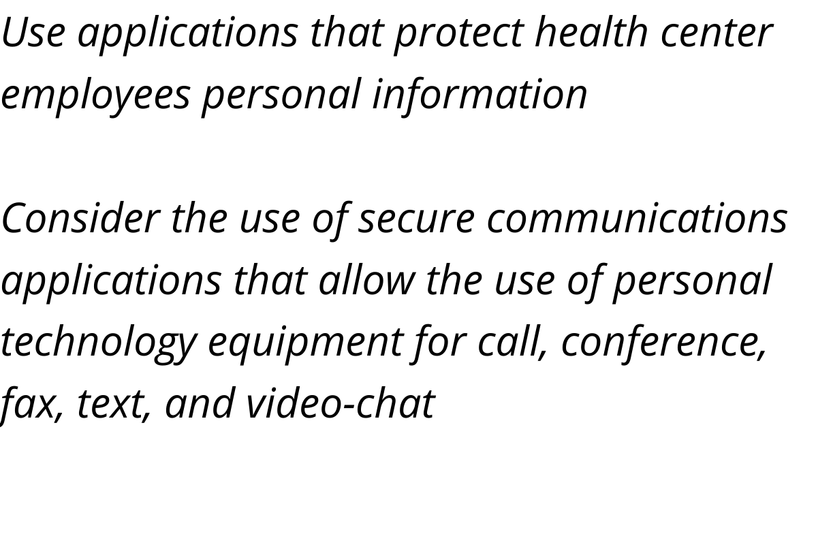
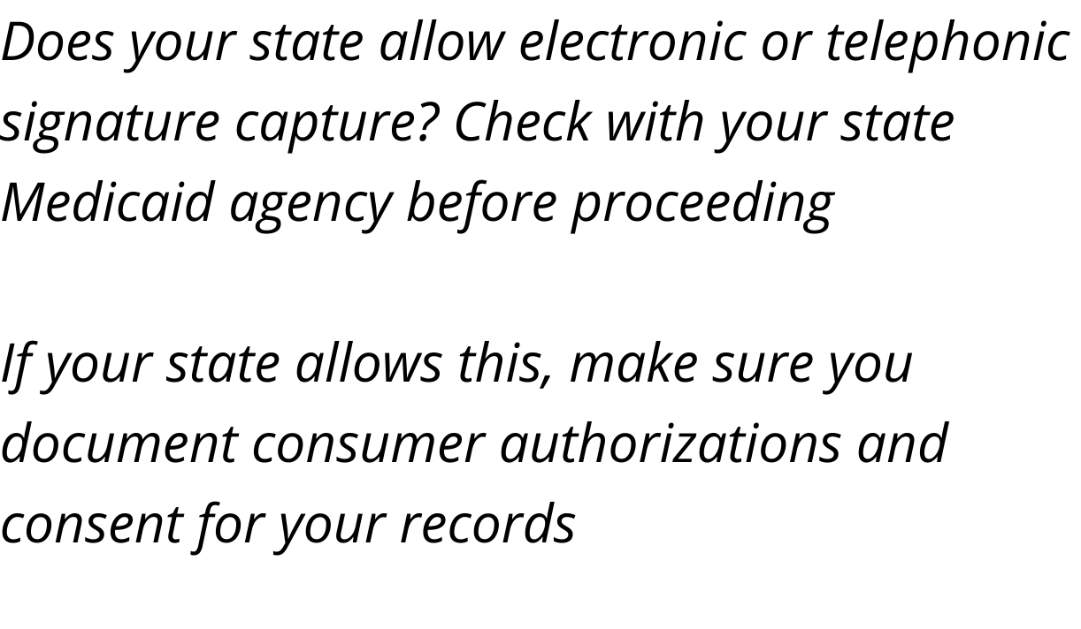
Red Flags & Caveats
Notes:
Just as important as keeping the consumer’s information safe, is ensuring that health center staff and their information is protected. Using secure applications that block phone numbers or allow for secure communication from personal technology equipment help protect the health center from breach.
Finally, Medicaid considerations are important and often some of the trickiest parts of enrolling people into coverage. Regulations vary state to state on whether or not electronic signature or telephonic signature can be captured, where some states like Texas don’t allow it at all, states like Illinois have created executive orders to allow it during COVID-19. If your state does allow electronic/telephonic signature capture, make sure you are documents any and all consumer authorizations and consent for your records for your security as much as the consumers.

Slide 12
Acknowledgements & Citations
Interview with Tia Whitaker, Pennsylvania Association of Community Health Centers [Telephone interview]. (2020, May 22).
Interview with Allen Gversvig, Arizona Alliance for Community Health Centers [Telephone interview]. (2020, May 19).
Interview with Sonia Lara, Texas Association of Community Health Centers [Telephone interview]. (2020, June 04).
Interview with Wisconsin Primary Health Care Association [Telephone interview]. (2020, June 08).
Arianna Anaya & Melissa McChesney. (Presenters). (2020). Providing Remote Enrollment Assistance [Webinar]. Center for Public Policy Priorities & Foundation Communities. Retrieved 2020, from https://zoom.us/rec/play/vsJ8dO2spzo3H9OQ4wSDAfZ6W9XsLqisgHBN8_MJxB7jUnYCN1OmZeAaa-oI93KR4RkIWtE6m-t28ZcM?continueMode=true&_x_zm_rtaid=GtaGOsjwQqKzWpk4Qexq-A.1591894402359.7055a596fe3be499a3a05a2413a6e93b&_x_zm_rhtaid=33
Center on Budget and Policy Priorities. (2020). Special Enrollment Periods [Webinar]. Retrieved from http://www.healthreformbeyondthebasics.org/oe8-special-enrollment-periods/

Slide 13
Acknowledgements & Citations
Center for Medicare & Medicaid Services. (2020). The Center for Consumer Information & Insurance Oversight. Retrieved from https://www.cms.gov/CCIIO/Resources/Regulations-and-Guidance Center for Medicare & Medicaid Services. (2020).
Center for Medicare & Medicaid Services. (2017). How to Obtain a Consumer’s Authorization before Gaining Access to Personally Identifiable Information (PII). Retrieved from https://marketplace.cms.gov/technical-assistance-resources/obtain-consumer-authorization.pdf
Certified application counselor designated organization (CDO) program information. Retrieved from https://marketplace.cms.gov/certified-application-counselor-designated-organization-cdo-program-information
Center for Medicare & Medicaid Services. (2020). Training for navigators, agents, brokers, and other assisters. Retrieved from https://marketplace.cms.gov/technical-assistance-resources/training-materials/training
Center for Medicare & Medicaid Services. (2019). 2019 Assister Certification Bulletin. Retrieved from https://marketplace.cms.gov/technical-assistance-resources/training-materials/assister-training-certification-bulletin.pdf
Health Resources & Services Administration. (2020). COVID-19 Frequently Asked Questions (FAQs). Retrieved from https://bphc.hrsa.gov/emergency-response/coronavirus-frequently-asked-questions

